Slide 1
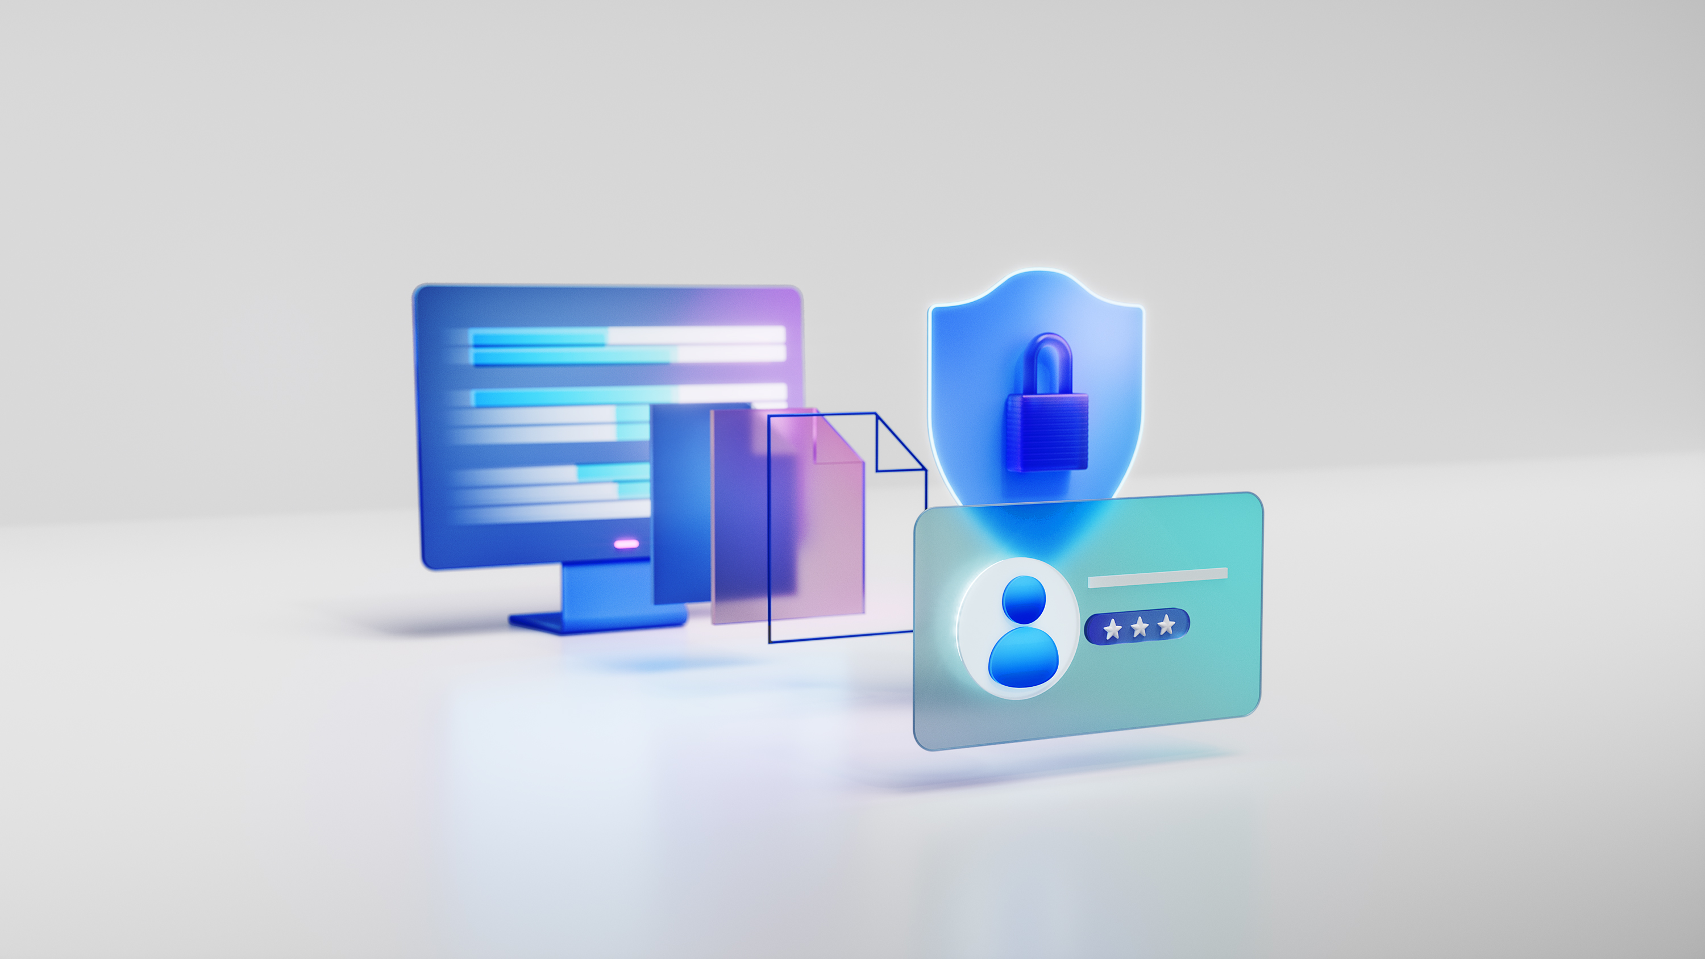
Azure Security

Slide 2

Agenda
Microsoft Security on Azure
Azure Security
Built-in Azure
Innovations
Closing
Appendix

Slide 3

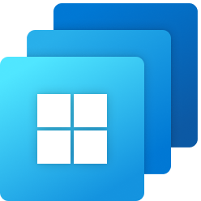
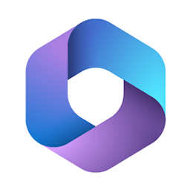
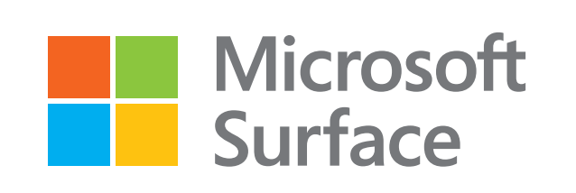

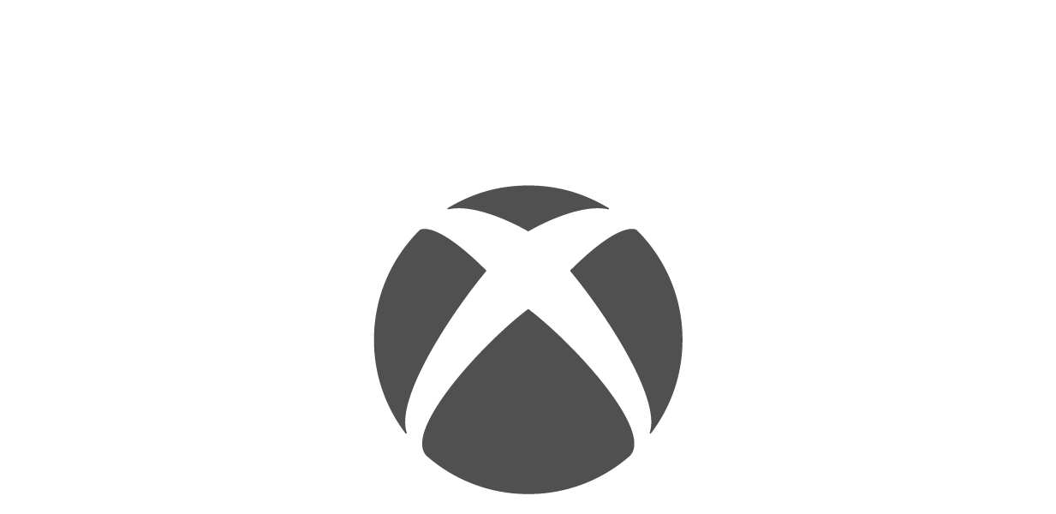

Microsoft security
Multicloud
Multiplatform
Windows
Microsoft
Surface
Microsoft
365
Microsoft security
Safeguarding people, data, and infrastructure
Microsoft
Teams
XBOX
Azure
Microsoft Cloud runs on Azure
Notes:
Microsoft is in a unique position to help our customers secure their highly distributed and hyper mobile environments with our end-to-end offerings. Evaluating their security posture isn’t a one-time event, it’s and ongoing effort.
We have the scope and resources to focus on providing best-in-class protection across the entire digital estate – identities, endpoints, data and emails, applications, and cloud.
And to be clear – we take a holistic approach, offering protection across multiple clouds [click] and multiple platforms.
We believe it’s no longer acceptable to deliver anything less than comprehensive security against digital threats. Threats can come from anywhere — whether bad actors trying to compromise credentials and breach your systems or employees not following privacy and encryption standards on sensitive data.
We do this through our portfolio of security offerings – six product families that integrate over 50 product categories.
With Microsoft Security, organizations can manage their threat landscape from end to end, providing customers with the most integrated and comprehensive security, compliance, and identity management solution portfolio on the planet.
By bringing the capabilities of these solutions together, we can natively integrate individual layers of protection to improve end-user experiences, decrease SecOps inefficiencies, and reduce the risk of costly data breaches and compliance violations.
We are helping organizations meet the challenges of a rapidly changing world so that they can seize the opportunity to grow and pioneer innovation with the industry’s most trusted and comprehensive cloud (Microsoft cloud).
The Microsoft Cloud is built on Azure: the global cloud computing platform powering transformation and growth. Azure lies at the foundation of the Microsoft Cloud and its capabilities – making it possible for organizations to securely embrace the latest technologies and leverage them to create new ones at rapid pace.

Slide 4
Microsoft Secure Future Initiative
The Microsoft Secure Future Initiative (SFI) is a multiyear initiative to evolve the way we design, build, test, and operate our products and services, to achieve the highest possible standards for security.
Notes:
What is it: SFI was (and still is) a multiyear initiative to improve the way we design, test, and operate software securely.
When and Why: We kicked off SFI last November, having accumulated learnings from threats all around us we were seeing, including our own incidents, and in anticipation of the threat landscape only getting worse.
Example of an incident where we learned a ton: Storm-0558 which was the incident investigated in the April 2024 CSRB report. This incident involved Chinese nation state attackers who used forged authentication tokens to access user email from approximately 25 organizations, including government agencies and related consumer accounts in the public cloud]
Original Scope: SFI was initially focused 3 priorities: (1) Strengthening identity protection, (2) driving more disciplined Secure by Design (in how we write/test code to meet high security standards), and (3) faster vulnerability response.
Why these 3 things
1: Identities is primary attack vector. Has been for years and will continue to be. It’s the easiest entry point
2. The way you secure software is start at the beginning. At the beginning is when software is designed, tested, before it gets released.
3. We needed to respond faster to customer’s questions/concerns about vulnerabilities

Slide 5

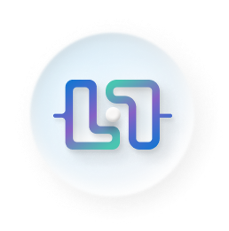
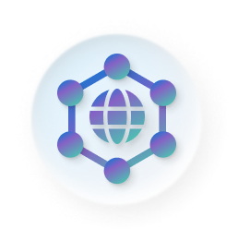
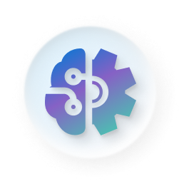
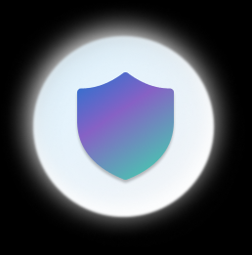
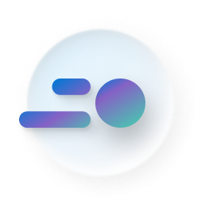
Secure Future Initiative (SFI)
Secure by design
Secure by default
Secure operations
Security culture and governance
Protect
identities and secrets
Protect tenants and isolate production systems
Protect network
Protect
engineering
systems
Monitor
and detect
threats
Accelerate response and remediation
Continuous improvement
Continuous improvement
Paved path
Paved path
Standards
Standards
Notes:
Basics of SFI framework are:
Elevating security and SFI across entire company – security above all else.
6 critical security pillars and organized teams to implement. Specifically, we’ve expanded the original SFI to now also include protect tenants, networks, and monitor and detect threats.
Continuously improving our standards and embedding them, we do this through paved paths, which makes it easier for engineers to adopt best practices
And ingraining secure by design/default/operations in everything we do

Slide 6

Shared responsibility
Customer responsibility
Shared
responsibility
Microsoft responsibility
Notes:
In an on-premises datacenter, you own the whole stack.
As you move to the cloud some responsibilities transfer to Microsoft.
This diagram illustrates the areas of responsibility between you and Microsoft, according to the type of deployment of your stack.
For all cloud deployment types, you own your data and identities. You're responsible for protecting the security of your data and identities, on-premises resources, and the cloud components you control. Cloud components you control vary by service type.
Regardless of the type of deployment, you always retain the following responsibilities:
Data
Endpoints
Account
Access management
Shared responsibility in the cloud - Microsoft Azure | Microsoft Learn
https://learn.microsoft.com/en-us/azure/security/fundamentals/shared-responsibility

Slide 7
Copilot for Security
Enable response in minutes, not hours
Protect at the speed and scale of AI
Simplify the complex with natural language prompts and easy reporting
It takes us three minutes to do a task that used to take at least a few hours.”
Catch what others miss with deeper understanding of your enterprise
Copilot for Security customer
Strengthen team expertise with cyber skills and promptbooks
Notes:
Microsoft Copilot for Security | Microsoft Security
With Copilot for Security, security analysts can move faster, so a shorter time to detection and response, and more time to focus on high value tasks. In fact, as you see here on the left, one specific customer reported that they could complete a task that used to take hours, now in just three minutes.
Another area where we see exponential gains in productivity is simplifying the complex, One specific capability where our private preview customers are seeing immense value is in natural language to kusto query language translation. Analysts don’t have to write complex scripts for tasks like threat hunting, Instead they can simply ask questions in natural language and Copilot for Security understands the context, sets the plan in motion, and writes the script. This results in time saved and unlocks new skills for perhaps more junior analysts.
Since Copilot for Security uses generative AI to analyze data from many sources, including Microsoft Security products, and Microsoft’s unrivaled threat intelligence, it can also help analysts to catch what they might have otherwise missed. We all know the signal to noise ratio is insane, but Copilot for Security synthesizes data and detects those important signals better than ever before, all in a single pane of glass, without having to jump between different solutions to get additional context.
Lastly, we’ve witnessed upskilling effects among security analysts in our private preview. Tier 1 analysts can now complete more complex tasks than they could before. With the global cybersecurity talent shortage where it is today, this means that organizations can see increases in productivity from their analysts and also can recruit and develop from a broader and more diverse talent pool. In addition to upskilling junior talent, Copilot for Security also helps senior security team members to expedite some of the mundane tasks they deal with daily and re-focus on strategic rather than tactical work, meaning they can be more proactive than reactive.
Microsoft also has some distinct advantages and differentiators. We’re bringing a lot to the table, in addition to just the generative AI models. Let’s take a look.
Next let’s talk about some of the specific benefits customers are already experiencing.
​

Slide 8
Copilot for Security advantage
Most advanced
general models
Hyperscale
infrastructure
Security-specific
orchestrator
Evergreen threat
intelligence
Cyber skills and
promptbooks
OpenAI
Microsoft
Security
+
+
+
Notes:
Our design behind Copilot for Security is not just taking OpenAI and rolling with it. We have the most advanced models available to anyone thanks to our partnership with OpenAI but we also have an advantage because of all that Microsoft brings to the table - hyperscale infrastructure, security-specific AI orchestration, Microsoft threat intelligence that’s informed by 65 trillion daily signals and then specific cyber skills and promptbooks coded into the product. So, as you can see, it’s much much more than just the large language model, and this is a big advantage for us.
I mentioned Threat Intelligence, which is an area where Microsoft really leads. Leads talk more about that.

Slide 9

1.5 million a day
Cloud Threats
Recent Cyber Attack pattern examples
Distributed Denial-
of-Service Attacks
Cloud Account Takeover
Surge in DDoS attacks during 2023 Holiday Season
Attack patterns shifted from previous year, showed significant sophistication and diversification
Azure DDoS Protection services played a crucial role in ensuring robust protection
Malicious nation state attackers used different techniques to gain access
Phishing lures within shared docs
Password spray attack
MFA manipulation used to maintain persistent access
Post compromise target activities – corporate email communication, data exfiltration
Notes:
Securing the cloud | Microsoft Story Labs
At any point in time on any day of the week, Microsoft’s cloud computing operations are under attack: We detect a whopping 1.5 million attempts a day to compromise our systems.
Unwrapping the 2023 holiday season: A deep dive into Azure's DDoS attack landscape | Microsoft Azure Blog
During the 2023 holiday season, there was a notable shift in attack patterns compared to the previous year, highlighting the evolving tactics of malicious actors to bypass DDoS protection strategies.
The season saw a surge in DDoS attacks, with a complex and evolving threat landscape that brought challenges along with the festive celebrations.
UDP-based attacks were predominant, particularly targeting gaming workloads and web applications, and accounted for 78% of the attacks.
Notable trends included the exploitation of misconfigured Docker API endpoints for botnet delivery and the emergence of NKAbuse malware leveraging blockchain technology.
The attack patterns observed during this period indicated a shift from the previous year, highlighting the continuous evolution of threat tactics.
Azure’s DDoS attack trends reflected global patterns, with attacks becoming increasingly politically motivated, partly due to geopolitical tensions.
DDoS-for-hire services, also known as “stressers” and “booters,” continued to be popular tools for attackers.
Azure’s DDoS Protection services were crucial in defending against these threats, ensuring robust protection for users during the holiday season
Microsoft Actions Following Attack by Nation State Actor Midnight Blizzard | MSRC Blog | Microsoft Security Response Center
Microsoft mitigates China-based threat actor Storm-0558 targeting of customer email | MSRC Blog | Microsoft Security Response Center

Slide 10
Innovate on trust with Microsoft Azure
Built-in security features
Advanced threat detection and mitigation
Backed by Microsoft Security R&D
Notes:
Microsoft Azure powers all aspects of Microsoft Cloud providing Limitless innovation for Microsoft and our customers.
We provide the expertise and technology you need to
Bring ideas to life by embracing emerging technology that transforms your organization with intelligent apps
Seamlessly unify technology to efficiently manage all your infrastructure, data, analytics and AI solutions across an integrated platform.
Innovate on trust, knowing you can rely on trusted technology from a partner who’s dedicated to your success

Slide 11

Achieve global-scale innovation on state-of-the-art cloud platform, reaching customers around the world
60+
300+
100+
Azure regions
Compliance certifications
datacenters
Notes:
Our capabilities span the globe. And even into Space! We’re constantly growing Azure globally by investing in datacenters, networking and cloud services so you can achieve global-scale innovation wherever you need it.
We have over 300 physical datacenters arranged into more than 60 regions – more regions than any other cloud provider – and linked by one of the largest interconnected networks on the planet. With this connectivity, we’re providing unprecedented scalability, low latency, data residency, and high availability to our customers around the world.
On top of that, Azure has over 100 compliance certifications (more than any other cloud provider) -including over 50 specific to global regions and countries, and more than 35 specific to the needs of key industries.
Our global approach empowers customers to flexibly innovate anywhere knowing their compliance needs are covered.
Sources:
Global Infrastructure | Microsoft Azure
Trust your cloud | Microsoft Azure

Slide 12
Azure offers unique security advantages
Azure security is
The only cloud platform built by a security vendor
Built-in
Simplified and streamlined security, built directly into Azure.
1M+ Microsoft security customers.
Modern
Protect, detect, and respond with AI and cloud scale.
10,000+ security experts employed.
Holistic
Helps secure hybrid and multi-cloud and works with what you have.
78 trillion signals every 24 hours.
Notes:
With our security approach on Azure, we give you built-in, modern, and holistic security.
Azure’s security capabilities are seamlessly built-in to the Azure platform, across all your cloud resources and all layers of architecture. It’s easy to turn on and easy to manage centrally, even through all stages of the development lifecycle, from native controls for the devops process to scalable security experiences for security operations teams. It also offers you broad policy support and actionable best practices.
Plus, with Azure, these security capabilities are truly best-in-class. You’re getting modern security powered by AI, with the scale of the cloud. Our solutions utilize AI trained on trillions of signals collected across Microsoft’s entire security portfolio. Built-in automation allows you to streamline common tasks so security professionals can focus on their most important tasks. And by moving security to the cloud, you get the flexibility to scale quickly and optimize your costs, lowering your total cost of ownership.
And most of all, Azure security is holistic. This isn’t just about protecting Azure – it’s about protecting your entire organization. It works with what you have, even across multiple clouds and platforms, to give you centrally managed, unified controls and visibility. It secures your hybrid resources. Plus, you also get the benefit of integrated threat protection through deep integration with Microsoft’s broader security portfolio, like Microsoft 365 Defender, to seamlessly secure your entire organization.
And Azure is uniquely equipped to give you the tools to help with today’s challenges, because Azure is the only cloud platform built by a security vendor. In fact, Microsoft operates a $10B security business.
We protect more than 1 million organizations our security, compliance, and identity solutions.
We employ more than 10,000 security experts and recently committed $20B in investment towards security.
Microsoft processes 78 trillion signals every 24 hours.
Signals matter because you cannot protect what you cannot see. The large-scale data advantage is what Microsoft Security brings to the table.
Microsoft has the insight of 65T daily signals to know what the attackers are doing and to empower you to protect yourself against these attacks.
We couple that with the expertise of global threat intelligence, monitoring more than 300+ threat groups, and the insight on attacker behaviors from more than 1M customers and over 15K partners.
With Azure, you’re getting the security expertise and intelligence that can only come from a true security vendor.

Slide 13



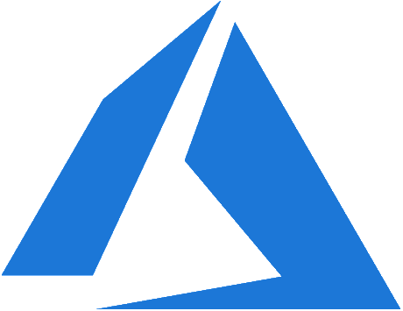






Azure Zero Trust security strategy
Secure by design | Secure by default
Identities
Applications
Microsoft
Entra ID
Continuous risk assessment & Automation
Microsoft Defender for cloud
Threat intelligence & Telemetry
Data
Security policy enforcement
Microsoft Defender for identity
Endpoints
Azure Information Protection
Infrastructure
Microsoft Defender
Microsoft Defender for cloud apps
Network
Microsoft Endpoint Manager
Secure operations
Notes:
Verify explicitly | Least privilege access | Assume breach
Zero Trust security in Azure | Microsoft Learn
How do I apply Zero Trust principles to Azure services? | Microsoft Learn
Security policy enforcement is at the center of a Zero Trust architecture. This includes Multi Factor authentication with conditional access that takes into account user account risk, device status, and other criteria and policies that you set.
Identities, devices (also called endpoints), data, applications, network, and other infrastructure components are all configured with appropriate security. Policies that are configured for each of these components are coordinated with your overall Zero Trust strategy. For example, device policies determine the criteria for healthy devices and conditional access policies require healthy devices for access to specific apps and data.
Threat protection and intelligence monitors the environment, surfaces current risks, and takes automated action to remediate attacks.
Strategies are in line with SFI's emphasis on creating a secure environment by design, ensuring secure operations, and maintaining trust in Azure's platform. Moreover, align with SFI's core principles of being Secure by Design, Secure by Default, and ensuring Secure Operations, which are foundational to Microsoft's commitment to security as outlined by Satya Nadella.
How do I apply Zero Trust principles to Azure IaaS? | Microsoft Learn

Slide 14
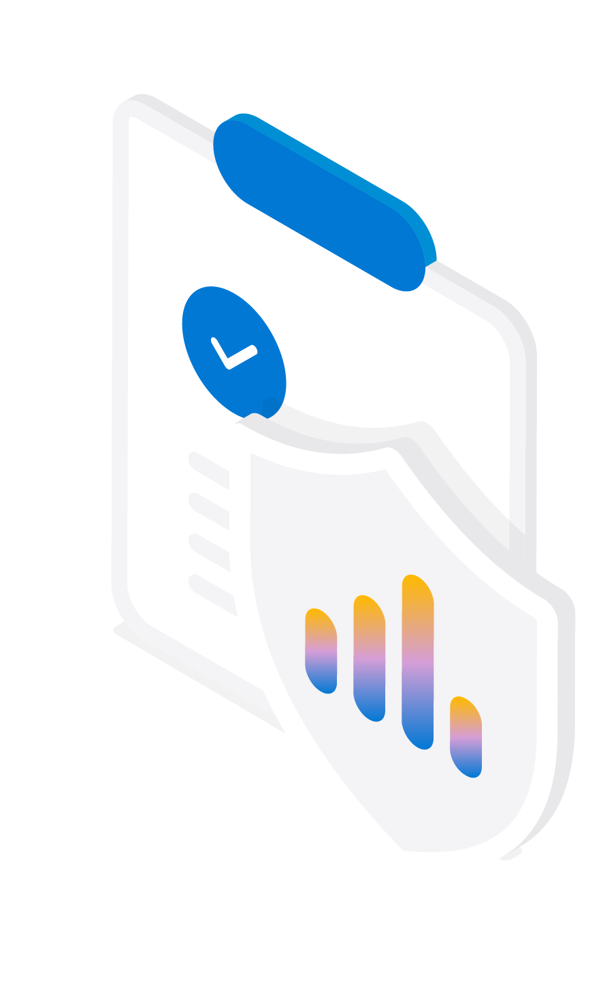
Maximize security capabilities
Identity & network access
Standardize on a single directory and identity across all platforms.
Use identity-based access control instead of security keys and secrets.
Reduce access to administrative groups/roles, especially Global Admin.
Ensure multi-factor authentication (MFA) is enforced for all user and administrator accounts and disable all legacy authentication protocols to prevent MFA bypass.
Do not allow administrative access from untrusted devices and applications.
Review the Risky Users report and actively investigate those user sign-ins.
Prioritize the consolidation of identity/security technologies.
MFA is one of the (5) key measures directed to be implemented across the federal government.
up to 90%
of cyber attacks can be prevented with MFA. US National Security Cyber Chief, Chris Inglis
99.9%
of automated attacks on Microsoft platforms, websites and other online services can be blocked by MFA.
Notes:
Additional references:
Microsoft Cloud Adoption Framework for Azure - Cloud Adoption Framework | Microsoft Learn
Microsoft Entra Plans and Pricing | Microsoft Security
Dataprot – https://dataprot.net/statistics/two-factor-authentication-statistics/
One simple action you can take to prevent 99.9 percent of attacks on your accounts (microsoft.com)

Slide 15




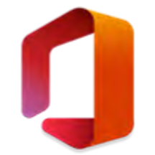
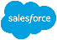






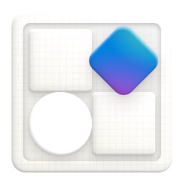
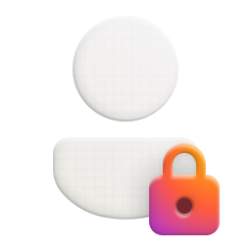
Unified identity management
Manage all your identities and access to all your applications across your hybrid environment
Employees
SaaS apps
Frontline workers
Microsoft Entra ID
Cloud-hosted apps
Customers
HR user data
Active Directory
On-premises and web apps
Partners
Notes:
Microsoft Entra ID (formerly Azure Active Directory)
Azure Active Directory (Azure AD) simplifies the way you manage and secure your applications by providing one identity system for both your cloud and on-premises apps. You can add your software-as-a-service (SaaS) applications, on-premises applications, and line-of-business (LOB) apps to Azure AD. Users only need to sign in once to securely and seamlessly access any application.
Why should you manage your identities from the cloud?​
The cloud is more secure. It offers the ability to train models and algorithms, then provides ways to seamlessly integrate solutions for better security than you can achieve on-premises.​
It provides a much better user experience with a common, seamless identity across cloud and on-premises.
It’s a much better experience for you. Manage all of your user identities in the cloud from a single screen.
Azure AD also works across your entire workforce identity infrastructure. Not only can you manage and secure employees, you can pull information from critical user-data stores. You can synchronize your on-premises Active Directory identities to Azure AD to enable a common user-identity experience and ensure consistent access, no matter your users’ location. You can also create external identities like partners and contractors, seamlessly collaborate with your users, and access your resources without having to create shadow accounts in your directories. Also, when you integrate with popular HR tools like Workday and SAP SuccessFactors, you can fast-track identity creation upon hire to offer seamless onboarding experiences.
​
And Azure AD isn’t just for managing identities. By joining your endpoints such as Windows, iOS, and Linux desktops, laptops, and mobile devices to your access infrastructure via Azure AD, you can leverage Microsoft Endpoint Manager to co-manage device workloads across ConfigMgr and Intune.
With Microsoft Endpoint Manager:
Protect user devices against threats using Zero Trust technologies
Simplify automated provisioning, configuration management, and updates for your endpoints

Slide 16
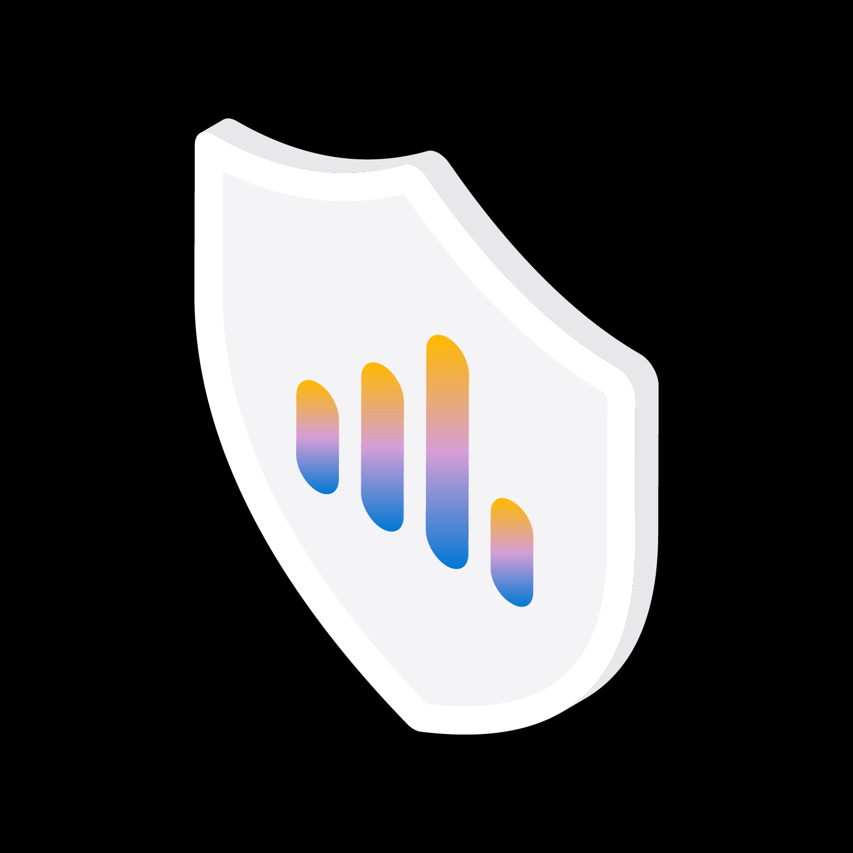
Risk reduction and posture management
Use Microsoft Defender
Review the current state using the Secure Score feature and address the top issues in priority order.
Review the Azure Security Baseline guidance to reduce risk across deployed workloads.
Ensure all aspects of cloud management are in-scope for monitoring and vulnerability management, including identity, devices, applications, and data.
$4.3M
average security breach cost
88%
of organizations that consolidate their security portfolio diminished their breach risk.
and..
Educate all teams about cloud security and the potential risks from mis-configuration, unpatched vulnerabilities, and potential social engineering
Ensure deployments are controlled through Azure policies, consider using Azure Arc for unified policy management for hybrid and multi-cloud scenarios
Validate all backups are immutable and test they can be used to recover the critical business applications and data when necessary
Notes:
Additional references:
Cloud Adoption Framework (CAF): https://docs.microsoft.com/en-us/azure/cloud-adoption-framework/secure/security-top-10
Secure Score: https://docs.microsoft.com/en-us/microsoft-365/security/defender/microsoft-secure-score-improvement-actions
Ponemon Institute Cost of Breach Data: https://www.ibm.com/security/data-breach
Forrester Consulting "Security through simplicity" study: https://info.microsoft.com/ww-landing-M365-Forrester-Security-through-simplicity-whitepaper.html

Slide 17




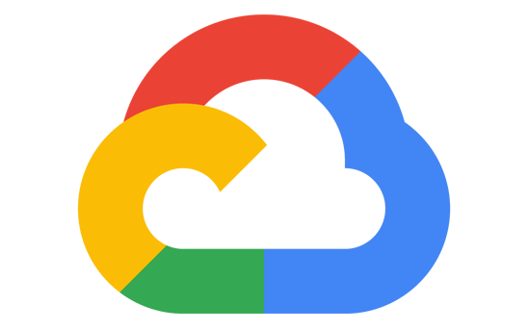
Strengthen your cloud security posture
Microsoft Defender for cloud
Reduce time spent on security policy and compliance management up to 30 percent*
Get a bird’s-eye view of your security posture with Secure Score
Continuously monitor and protect your multicloud and hybrid resources
Follow best practices recommendations with Azure Security Benchmark
Get visibility into the state of compliance across Azure, AWS, and Google Cloud
SQL
VMs
Containers
Network
IoT
Apps
Microsoft Azure
Amazon Web Services
Google Cloud
Multicloud
*Source: Forrester Consulting, “The Total Economic Impact™ of Securing Apps with Microsoft Azure Active Directory,” August 2020, commissioned by Microsoft.
Notes:
Source: Forrester Consulting, “The Total Economic Impact of Microsoft Azure Security Center,” February 2021, commissioned by Microsoft.
Microsoft Defender for Cloud makes it easier to strengthen your cloud security posture. A recent “Total Economic Impact” study by Forrester Consulting found that when organizations used Microsoft Defender for Cloud, they reduced the time spent on security policy and compliance management by up to 30 percent.
When you use Microsoft Defender for Cloud , it continuously assesses the security state of your cloud resources across virtual machines, networks, apps, and data services. It also continuously discovers new resources as they deploy across your workloads and assesses whether they are configured according to security best practices.
If any anomalies are found, the system flags them and also provides a prioritized list of recommended fixes.
A key component of is the Secure Score. It provides a bird’s eye view into your current state and recommends actions to help prioritize steps you can take to improve your security posture. For example, it might offer recommendations to prevent common misconfigurations, such as exposure of sensitive resources to the internet, lack of encryption, uninstalled updates, or a missing firewall for your cloud workloads.
With Azure Arc support, you gain visibility into the posture of not just Azure, but also Google Cloud and Amazon Web Services, as well as your hybrid environment, including Windows and Linux servers. It provides you with a unified, multicloud security posture from a single screen.

Slide 18

Governance with Azure
Build a cloud governance team
Assess cloud risks
Document cloud governance policies
Enforce cloud governance policies
Monitor cloud governance policies
Notes:
Cloud governance is how you control cloud use across your organization.
Cloud governance sets up guardrails that regulate cloud interactions. These guardrails are a framework of policies, procedures, and tools you use to establish control. Policies define acceptable and unacceptable cloud activity, and the procedures and tools you use ensure all cloud usage aligns with those policies. Successful cloud governance prevents all unauthorized or unmanaged cloud usage.
The Cloud Adoption Framework (CAF) Govern methodology provides a structured approach for establishing and optimizing cloud governance in Azure. The guidance is relevant for organizations across any industry. It covers essential categories of cloud governance, such as regulatory compliance, security, operations, cost, data, resource management, and artificial intelligence (AI).
Resource: Govern overview - Cloud Adoption Framework | Microsoft Learn

Slide 19

Azure Key Vault
Safeguard cryptographic keys and other secrets used by cloud apps and services.
Increase security and control over keys and passwords
Use FIPS 140-2 Level 2 and Level 3 validated HSMs
Create and import encryption keys in minutes
Reduce latency with cloud scale and global redundancy
Applications have no direct access to keys
Simplify and automate tasks for SSL/TLS certificates
Notes:
https://azure.microsoft.com/en-us/products/key-vault
Azure Key Vault is a cloud service for securely storing and accessing secrets. A secret is anything that you want to tightly control access to, such as API keys, passwords, certificates, or cryptographic keys. Key Vault service supports two types of containers: vaults and managed hardware security module(HSM) pools. Vaults support storing software and HSM-backed keys, secrets, and certificates. Managed HSM pools only support HSM-backed keys.

Slide 20
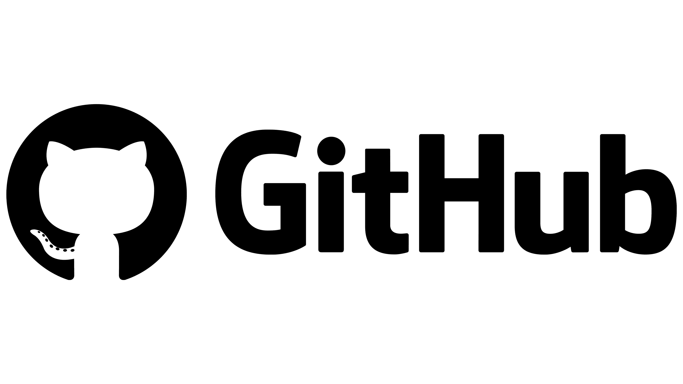




Build secure apps from the start
Implement integrated DevSecOps for secure development and deployment of applications.
Supply chain
Deploy secure code across clouds–Azure, AWS, Google Cloud, and others
Helps reduce security effort, increase development speed, and improve application security
Focus on actionable and high priority security issues within the developer workflow
Have peace of mind with enforced security and compliance policies
Provide central visibility to security admins through Microsoft Defender for Cloud integration
Code
Development lifecycle
Shift-left with secure DevOps
Notes:
A comprehensive approach to DevOps is critical to the fast and reliable delivery of applications to your environment. At the same time, it’s critical you ensure the security of your applications, and that you integrate that security into the entire application development, deployment, and maintenance lifecycle. Securing your code is just as important as securing your cloud resources and SaaS apps. Consider the following:
94% of projects use open source1
85% of codebases have components that are >4 years old2
83% of vulnerabilities are caused by dev errors1
GitHub and Azure have all the tools you need to quickly build a secure application. Identify potential threats before you deploy your application into production using the Microsoft threat-modeling tool. Perform static and dynamic code analysis to find vulnerabilities in your code using Semmle, which GitHub recently acquired. Additionally, examine the dependencies your application has on open-source libraries or components and check for security risks using Dependentabot. Make sure you haven’t embedded your secrets such as connection strings and keys into your code, but store them securely in repositories backed by hardware security modules. You can do that using CredScan and Azure Key Vault. These tools are all integrated into your existing DevOps environment, whether they come from Microsoft or the open-source ecosystem.
It’s also important to protect all of your stack layers, such as on a standard three-tiered app, by protecting user identities and supporting multi-factor authentication. Use firewalls such as the Azure WAF to protect applications with public-facing IP addresses. In Azure, to protect your data while it’s at rest and in transit, we take data encryption to the next level with protection that extends to data while it’s in use via hardware enclaves in our confidential computing family of VMs.
It takes several steps to secure your applications. To help with those tasks, Microsoft provides best-practices documentation as well as the Secure DevOps toolkit. This helps to accelerate your workflow to ensure you protect your applications.
Now let’s talk specifically about securing open-source applications. Open source is instrumental in helping you deliver innovative apps. According to the Synopsys Open-Source Security report for 2019, 99 percent of enterprise codebases with more than 1,000 files contained open-source components. Open source’s popularity, however, makes it an easier target for attacks. That’s why it’s important to make sure you improve your security posture, which is not a trivial task. The Synopsys report also found that 85 percent of codebases had components more than four years old, and 60 percent had at least one known vulnerability. That should not be the case.
GitHub can play an instrumental role in helping you secure your open-source applications. Secure your software supply chain by tracking and patching all of your dependencies and setting alerts using Dependabot and Dependency Insights. GitHub can also help integrate security into your code-to-cloud workflows by scanning for thousands of vulnerabilities and protecting against leakage of secrets. You can perform code analysis using Semmle for static and dynamic code, and leverage GitHub token scanning to protect secrets. GitHub also provides extensive resources and community-powered queries to help facilitate your application development.
GitHub offers multiple features to help you protect your open-source applications, and you can expect further investments in this space to help you develop your applications securely.
1 State of the Octoverse 2020 report
2 Synopsys Open-Source Security report, 2019

Slide 21

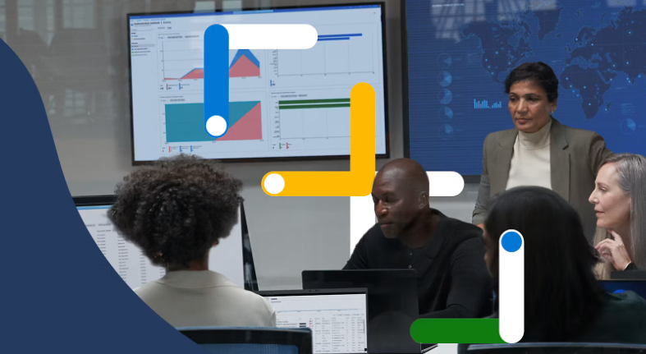


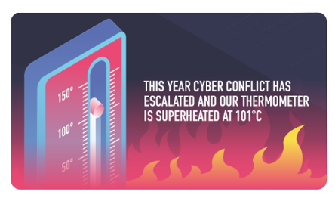
Microsoft global security operations
Safeguarding data, infrastructure and people.
Global threat intelligence
Microsoft security experts
Microsoft Intelligence Security Association
Microsoft Digital Crimes Unit
Cybersecurity Tech Accord
Notes:
Microsoft is THE leading security company both for the products that we have developed, but more importantly the people that have done the research, fight crime, investigate nation-state actor behaviors, and go to the law courts to ensure bot-nets and other attacker infrastructure are permanently removed from the internet
Within the global security community, Microsoft has a strong reputation for the work our teams do both within Microsoft (red team / blue team), and with our industry partners (including Amazon, Google, Mandiant, Proofpoint and more), ensuring all our customers are well protected from next-level threats every day.
Microsoft Security Experts
Extend your ability to defend and manage with a new line of services from the experts at Microsoft.
Microsoft Threat Intelligence
Microsoft is dedicated to exposing and eliminating modern cyberthreats and their infrastructure using dynamic threat intelligence built from 78 trillion signals and more than 10,000 multidisciplinary experts worldwide.
Microsoft Intelligent Security Association
The Microsoft Intelligent Security Association (MISA) consists of Microsoft premiere security partners—independent software vendors (ISVs) and managed security service providers (MSSPs) that have integrated their solutions with Microsoft Security products.
Microsoft Digital Crimes Unit
Microsoft’s Digital Crimes Unit (DCU) is an international team of technical, legal and business experts that has been fighting cybercrime, protecting individuals and organizations, and safeguarding the integrity of Microsoft services since 2008. Our expertise and unique insights into online criminal networks enable us to uncover evidence used in our criminal referrals to law enforcement. The DCU also works to increase the operational cost of cybercrime by disrupting the infrastructure used by cybercriminals through civil legal actions and technical measures.

Slide 22
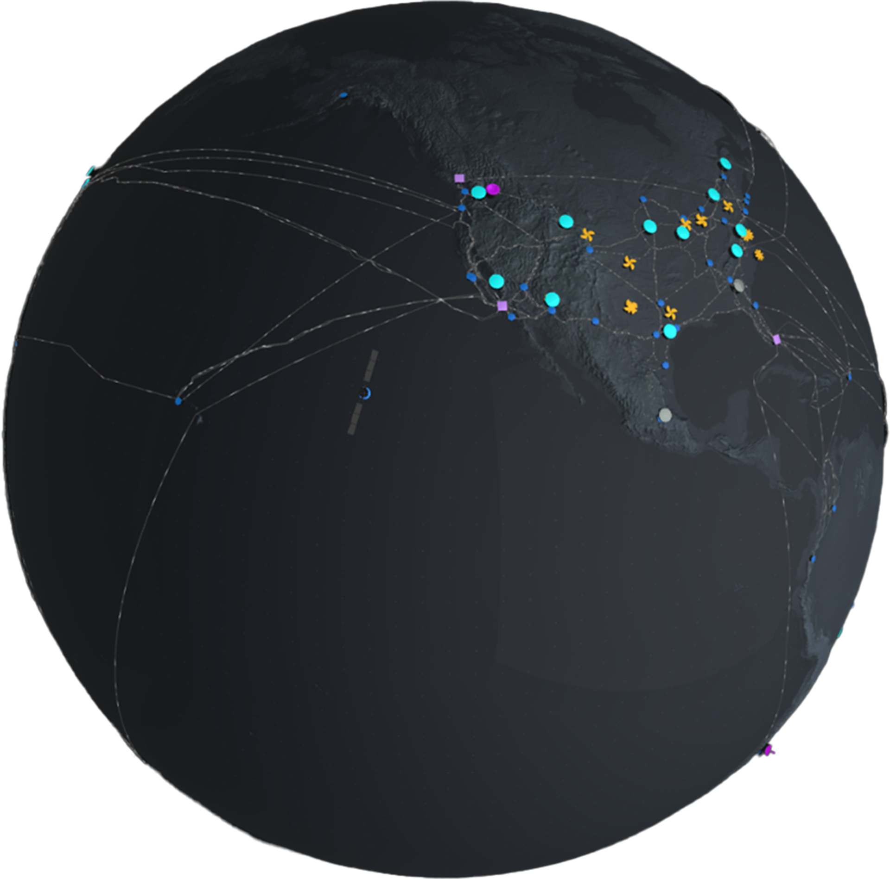
Project Cerberus
We provide a strong anchor of trust for firmware integrity with chip designs that support system- and server-level security.
Notes:
In continuing to supply a secure, reliable, and trusted cloud platform, we have also made security considerations for our chip design. Cerberus is a NIST 800-193 compliant hardware root-of-trust with an identity that cannot be cloned. This anchor of trust helps defend platform firmware from:
Compromised firmware binaries running on the platform
Malware and hackers that exploit bugs in the operating system, application, or hypervisor.
Certain types of supply chain attacks (manufacturing, assembly, and transit)
Malicious insiders with administrative privileges or access to hardware.

Slide 23
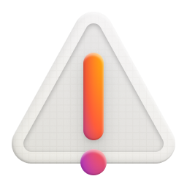
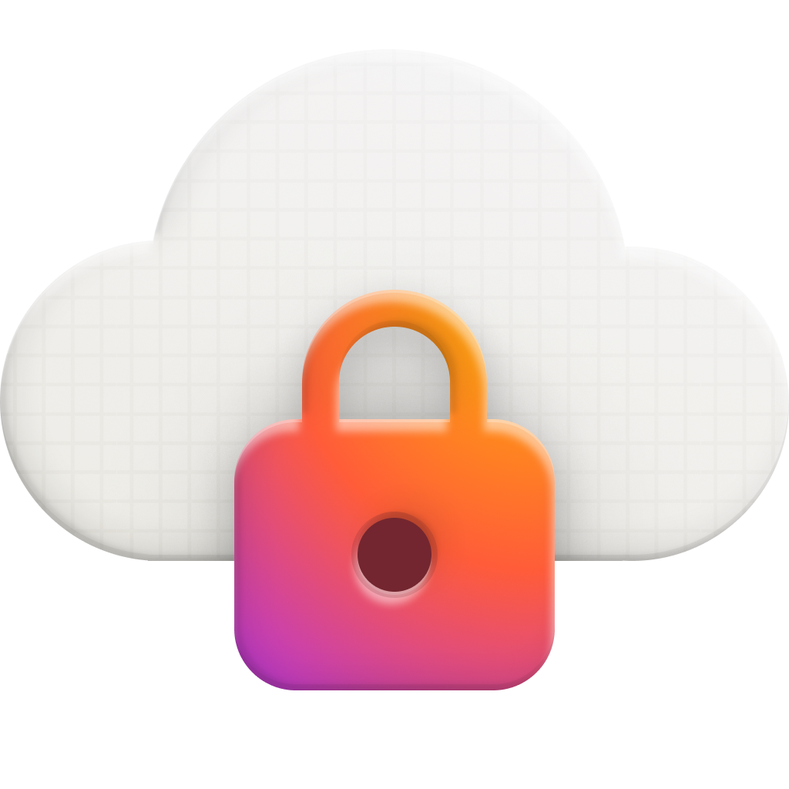
Microsoft’s Responsible AI Framework
Reliability & safety
Privacy & security
Fairness
Inclusiveness
Transparency
Accountability
AI systems should treat all people fairly.
AI systems should perform reliably and safely.
AI systems should be secure and respect privacy.
AI systems should empower everyone and engage people.
AI systems should be understandable.
People should be accountable for AI systems.
Learn more
www.microsoft.com/ai/responsible-ai
Notes:
At Microsoft we believe that the development and deployment of AI must be guided by the creation of an ethical framework. As part of that, we have identified six core components that guide our work around AI, each of them critical to the safety of AI. We are passionate and committed to this framework for the development and use of our own AI and as best practice for our industry.
I encourage you to learn more about Microsoft’s Responsible AI Framework.

Slide 24
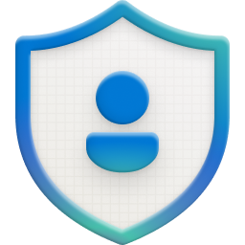
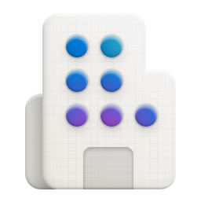

Microsoft datacenter layered security approach
Prior access request process
Approval
required
Access granted for specific areas and time
Access requests
Security
cameras
Secured entry
checkpoint
Security
patrols
Fencing
Barriers
Facility perimeter
Security
control center
Full body
metal detectors
Required
check in/out
Access only to pre-approved areas
2-factor authentication with biometrics
24 x 7 security staff
Building
2-factor authentication with biometrics
Full body
metal detectors
Only approved
devices
Security
cameras
Alarms
Datacenter floor
Notes:
Microsoft datacenters employ controls at the perimeter, building, and computer room with increasing security at each level, utilizing a combination of technology and traditional physical measures.
Security starts at the perimeter with camera monitoring, security officers, physical barriers and fencing.
At the building, seismic bracing and extensive environmental protections protect the physical structure and integrated alarms, cameras, and access controls (including two-factor authentication via biometrics and smart cards) govern access. The systems are monitored 24x7 from the operations center.
Similar access controls are used at the computer room, which also has redundant power.
To reduce the risk of unauthorized users gaining physical access to data and the datacenter resources, Microsoft takes a layered approach to physical security. Datacenters managed by Microsoft have extensive layers of protection: access approval at the facility’s perimeter, at the building’s perimeter, inside the building, and on the datacenter floor. Layers of physical security are:
Access request and approval: You must request access prior to arriving at the datacenter. You're required to provide a valid business justification for your visit, such as compliance or auditing purposes. All requests are approved on a need-to-access basis by Microsoft employees. A need-to-access basis helps keep the number of individuals needed to complete a task in the datacenters to the bare minimum. After Microsoft grants permission, an individual only has access to the discrete area of the datacenter required, based on the approved business justification. Permissions are limited to a certain period of time, and then expire.
Facility perimeter: When you arrive at a datacenter, you're required to go through a well-defined access point. Typically, tall fences made of steel and concrete encompass every inch of the perimeter. There are cameras around the datacenters, with a security team monitoring their videos at all times.
Building entrance: The datacenter entrance is staffed with professional security officers who have undergone rigorous training and background checks. These security officers also routinely patrol the datacenter and monitor the videos of cameras inside the datacenter at all times.
Inside the building: After you enter the building, you must pass two-factor authentication with biometrics to continue moving through the datacenter. If your identity is validated, you can enter only the portion of the datacenter that you have approved access to. You can stay there only for the duration of the time approved.
Datacenter floor: You are only allowed onto the floor that you're approved to enter. You are required to pass a full body metal detection screening. To reduce the risk of unauthorized data entering or leaving the datacenter without our knowledge, only approved devices can make their way into the datacenter floor. Additionally, video cameras monitor the front and back of every server rack.
Leaving the datacenter: When you exit the datacenter floor, you again must pass through full body metal detection screening. To leave the datacenter, you're required to pass through an additional security scan.
Leaving the facility: Microsoft requires visitors to surrender badges upon departure from any Microsoft facility.

Slide 25


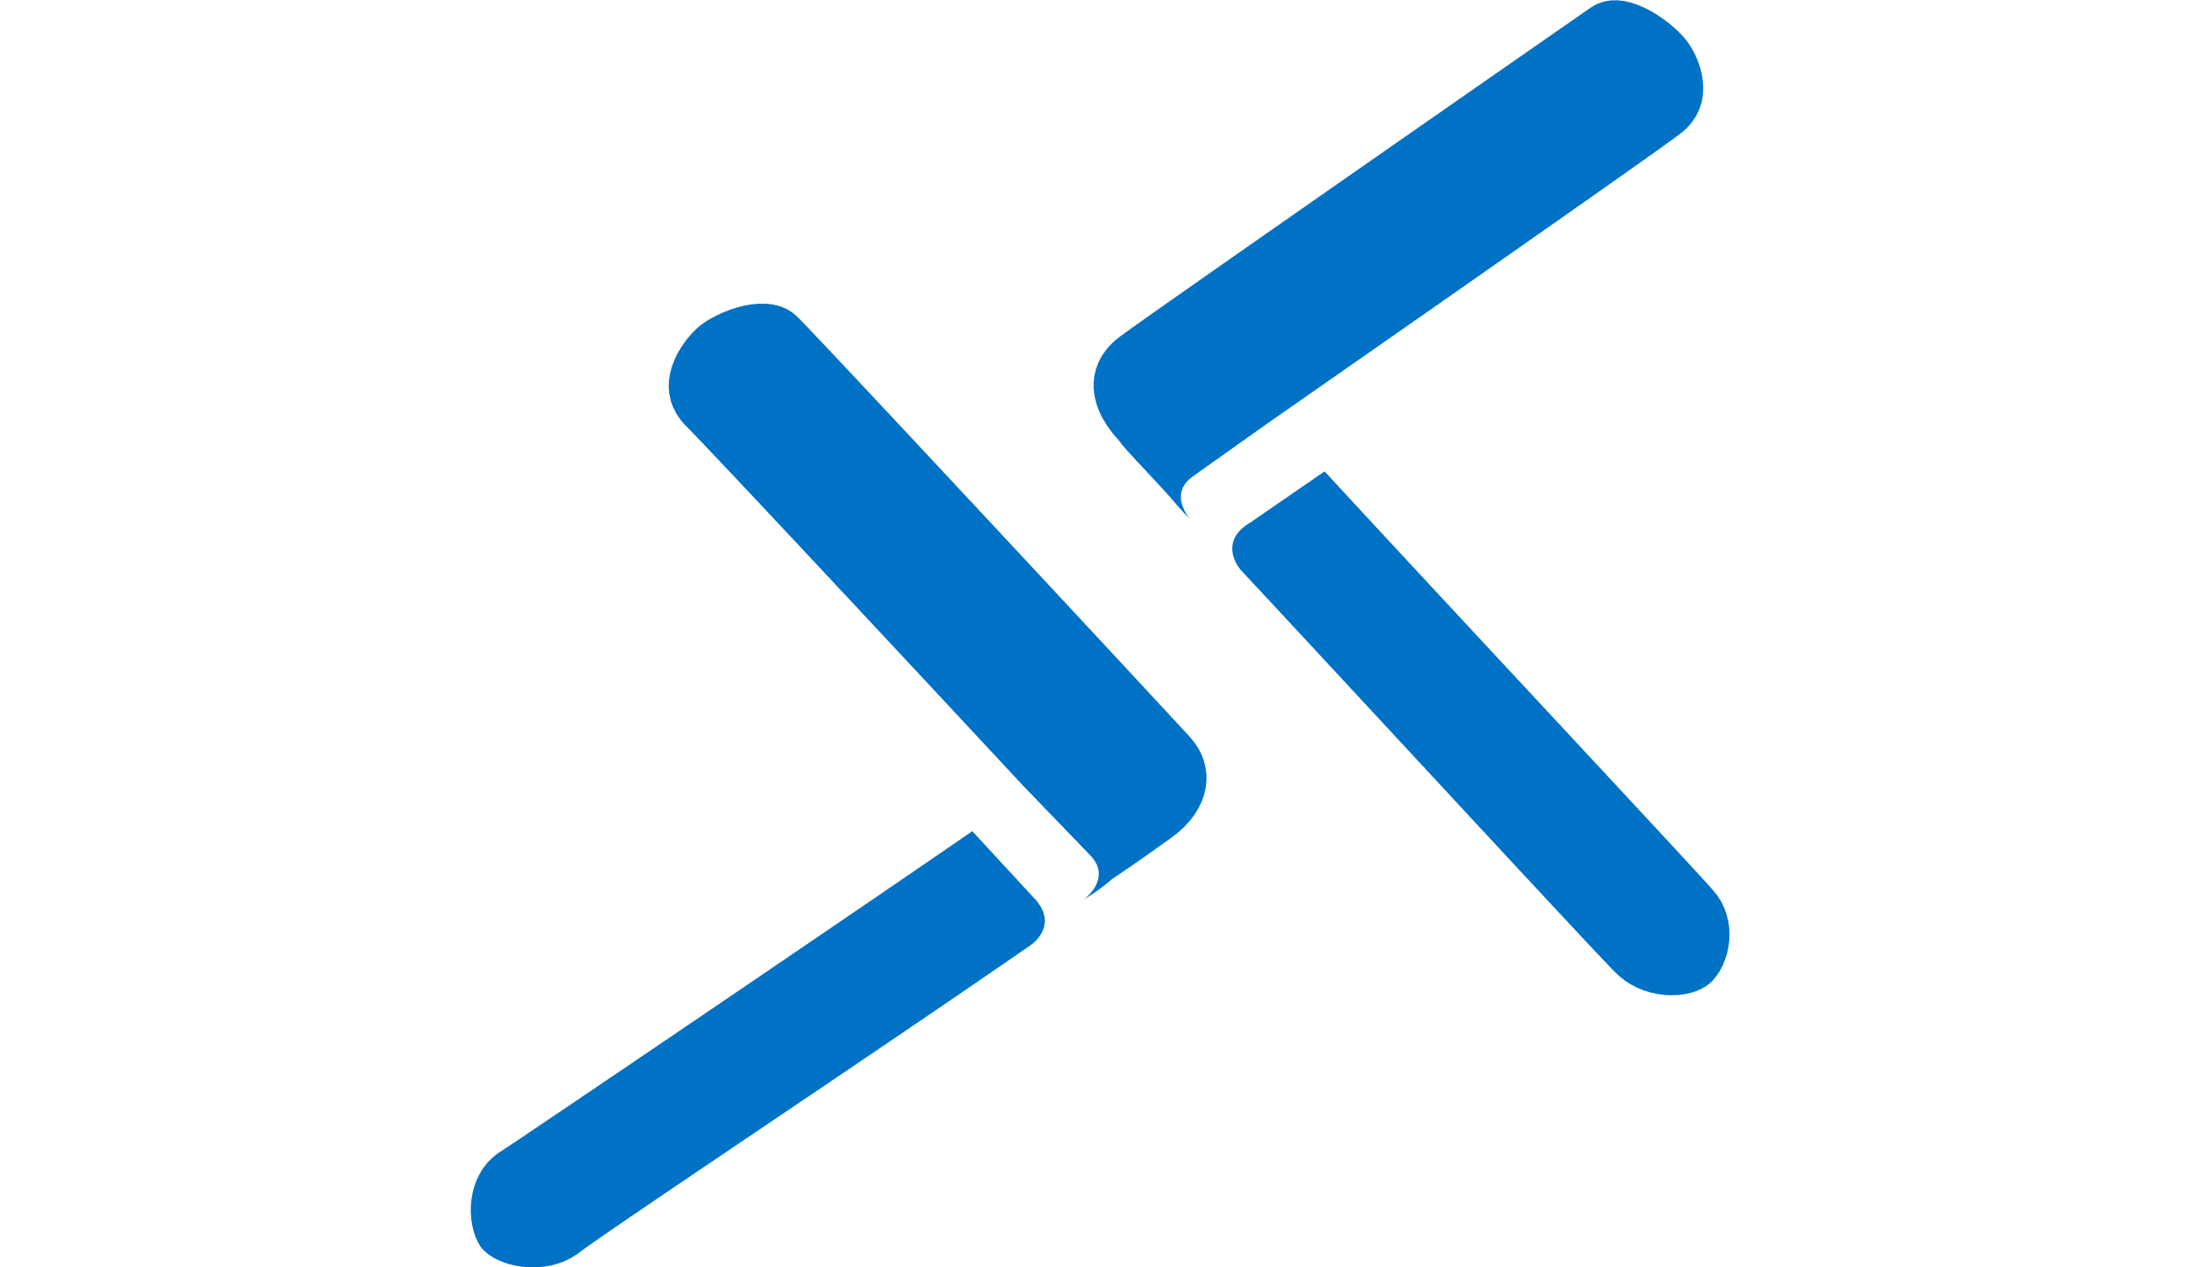

Building Zero Trust into cloud and hybrid network
Azure network security
Infrastructure security
Application security
Azure Web Application
Firewall (regional & global)
Azure Firewall
Azure DDoS Protection
Azure Bastion
Segmentation
controls
Intelligent
threat protection
Traffic
encryption
Private
access
Defense-in-depth protection from edge to cloud
Notes:
Secure your network infrastructure and applications
Azure network security offers the full benefits of cloud-native services for securing your cloud and hybrid network infrastructure and applications. Based on Zero Trust network security, these services are designed to provide organizations with granular segmentation controls, intelligent threat protection by Microsoft Threat Intelligence, traffic encryption in-transit/at rest and private access linking to Iaas/PaaS/on-premises resources.
Unlike partner solutions that run on network virtual appliances (NVA), Azure network security services are cloud-native built to maximize agility while providing auto-scaling, high availability and tight integration with DevOps and Azure services. The flexibility, ease of deployment and maintenance combined with a lower cost for protection makes it ideal for customers looking for agile protection.

Slide 26


Azure network security
Layered defense approach with cloud native services
A Zero Trust approach
Stop attacks at Network edge
Use virtual network for network segmentation
Control routing behavior
Use Service Endpoints to restrict access to PaaS resources
Optional virtual network encryption for added security
Deployments
NSG/ASG and UDR
Application Gateway with WAF
Azure Firewall
Virtual Network Isolation
DDoS Protection
Front Door with WAF
Internet
Notes:
As part of your defense-in-depth strategy, you should use a combination of cloud native services from Azure network security to create a layered defense. This is to stop attacks as far from your digital assets as possible by applying security at the edge. You should architect your virtual network carefully by doing network segmentation, and apply strong controls and protection like Firewall, Web application Firewall and DDoS Protection to increase the difficulty for a hacker to penetrate your networks.
Resource:
What is Azure Virtual Network encryption? - Azure Virtual Network | Microsoft Learn

Slide 27

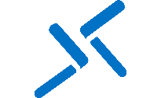
Network infrastructure security
Threat
Protection
Segmentation
Encryption
Azure Firewall
Azure DDOS Protection
Azure Bastion
Build and protect your virtual network infrastructure
Security admin rules
Virtual
Network
Network
Security Group
Azure
Private Link
Supporting Azure Networking services
Notes:
Azure provides a comprehensive set of security services that enable network protection for Azure, hybrid or multi-cloud.
Azure Firewall is a cloud-native and intelligent network firewall security service that provides the best of breed threat protection for your cloud workloads running in Azure. It's a fully stateful firewall as a service with built-in high availability and unrestricted cloud scalability. It provides both east-west and north-south traffic inspection.
What is Azure Firewall? | Microsoft Learn
Distributed denial of service (DDoS) attacks are some of the largest availability and security concerns facing customers that are moving their applications to the cloud. A DDoS attack attempts to exhaust an application's resources, making the application unavailable to legitimate users. DDoS attacks can be targeted at any endpoint that is publicly reachable through the internet.
Azure DDoS Protection, combined with application design best practices, provides enhanced DDoS mitigation features to defend against DDoS attacks. It's automatically tuned to help protect your specific Azure resources in a virtual network. Protection is simple to enable on any new or existing virtual network, and it requires no application or resource changes.
Azure DDoS Protection Overview | Microsoft Learn
The Bastion Developer SKU is a free, lightweight SKU. This SKU is ideal for Dev/Test users who want to securely connect to their VMs, but don't need additional Bastion features or host scaling. With the Developer SKU, you can connect to one Azure VM at a time directly through the virtual machine connect page.
Resource: Quickstart: Deploy Bastion using the Developer SKU: Azure portal | Microsoft Learn
By using security admin rules, you can enforce allowed traffic and prevent denial by conflicting network security group rules. You can also create default security admin rules that don't depend on NSGs to exist. These default rules can be especially useful when application owners misconfigure or forget to establish NSGs. Additionally, security admin rules provide a way to manage security at scale, which reduces the operational overhead that comes with a growing number of network resources. Resource: Security Admin Rules in Azure | Microsoft Learn

Slide 28
Application security
Threat
Protection
Segmentation
Encryption
Web Application Firewall on Azure Front Door (global)
Web Application Firewall on Azure Application Gateway (regional)
Build and secure your global applications and APIs
Azure
CDN
Azure DDoS
Protection
Azure
Private Link
Supporting Azure Networking services
Notes:
Azure provides a comprehensive set of security services that protect your global applications and APIs.

Slide 29
Encryption built into Azure
At rest
In transit
In use
Encrypt VM disks, storage, and data
Encrypt data on the wire
Utilize hardware-based secure enclaves
Management of keys, secrets, and certificates, backed by hardware security modules
Notes:
Let’s talk about the data protection built into Azure.
Protecting your data throughout its lifecycle and wherever it resides is the most critical step to safeguard your business. Azure offers a breadth of options to ensure the privacy and security of your data. Data encryption at rest is a mandatory step toward data privacy, compliance, and data sovereignty.
Azure disk encryption enables IT administrators to encrypt Windows and Linux IaaS VM disks. Disk encryption combines the industry-standard Windows BitLocker feature and the Linux dm-crypt feature to provide volume encryption for the OS and the data disks. Services like Azure storage and Azure SQL database encrypt data at rest by default, and many services offer encryption as an option.
Organizations that fail to protect data in transit are more susceptible to man-in-the-middle attacks, eavesdropping, and session hijacking. These attacks can be the first step attackers use to gain access to confidential data.
Security is a key concern when you move extremely sensitive IP and data scenarios to the cloud. You can secure data at rest and in transit, but you also need to protect your data from threats when it’s processing. Now you can. Confidential computing adds new data-security capabilities that use trusted-execution environments (TEEs) or encryption mechanisms to protect your data while in use. Azure permits only authorized code to run in the TEE container and to access data, which protects your code and data against viewing and modification from outside of TEE.
In addition, centralizing storage of application secrets in Azure Key Vault allows you to control their distribution. Key Vault greatly reduces the chances that secrets may accidentally get leaked. Using Key Vault reduces risk because application developers no longer need to add security information to their code and store it in their applications. Together, these built-in controls make it easier for you to protect data for services across your software-as-a-service (SaaS), platform-as-a-service (PaaS), and infrastructure-as-a-service (IaaS) cloud models.
Note—additional detail if needed: At-rest examples: Azure storage service encryption
SQL Server transparent database encryption (TDE)
In-transit examples: HTTPS
TLS
In-use examples: Trusted execution environments such as Intel SGX and VBS
Homomorphic encryption
Secrets management: Azure Key Vault can be used to securely store and tightly control access to tokens, passwords, certificates, API keys, and other secrets.
Key management: You can also use Azure Key Vault as a key management solution. Azure Key Vault makes it easy to create and control the encryption keys used to encrypt your data.
Certificate management: Azure Key Vault lets you easily provision, manage, and deploy public and private secure sockets layer/transport layer security (SSL/TLS) certificates for use with Azure and your internal connected resources.
Hardware security modules (HSM): Store and protect your secrets and keys either by software or FIPS 140-2 Level 2, which validates HSMs.

Slide 30
Azure Confidential Computing
EXISTING ENCRYPTION
CONFIDENTIAL COMPUTING
Data at rest
Data in transit
Data in use
Encrypt inactive data when stored in blob storage, database, etc.
Encrypt data that is flowing between untrusted public or private networks
Protect/encrypt data that is in use, while in RAM, and during computation
Protect against
Insider threat
privileged admins or insiders
Hackers
exploiting bugs in the Hypervisor/OS
Third parties
accessing data without customer consent
Notes:
Secure your sensitive and regulated data while it's being processed in the cloud.
Azure confidential computing encrypts data in memory in hardware-based trusted execution environments and processes it only after the cloud environment is verified, helping prevent data access by cloud providers, administrators, and users.
Build on top of secure hardware using familiar tools, software, and cloud infrastructure, or migrate your existing workloads and applications.
Combine datasets confidentially, without exposing your data to other contributing organizations. Benefit from confidential computing and great AI and machine learning insights. Upload encrypted data to a secure enclave in a virtual machine and perform algorithms on datasets from multiple sources.

Slide 31

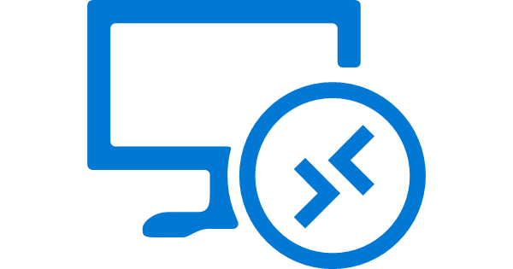
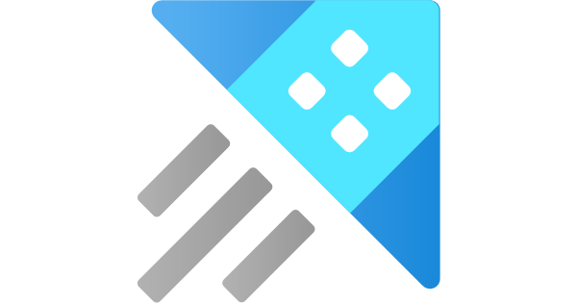



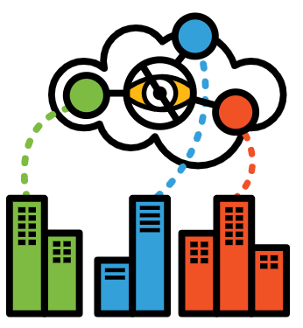


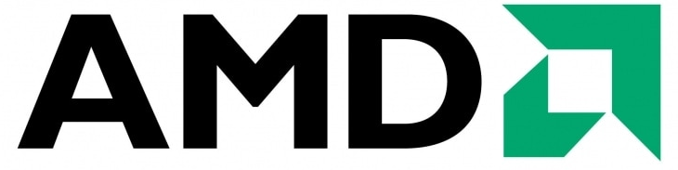
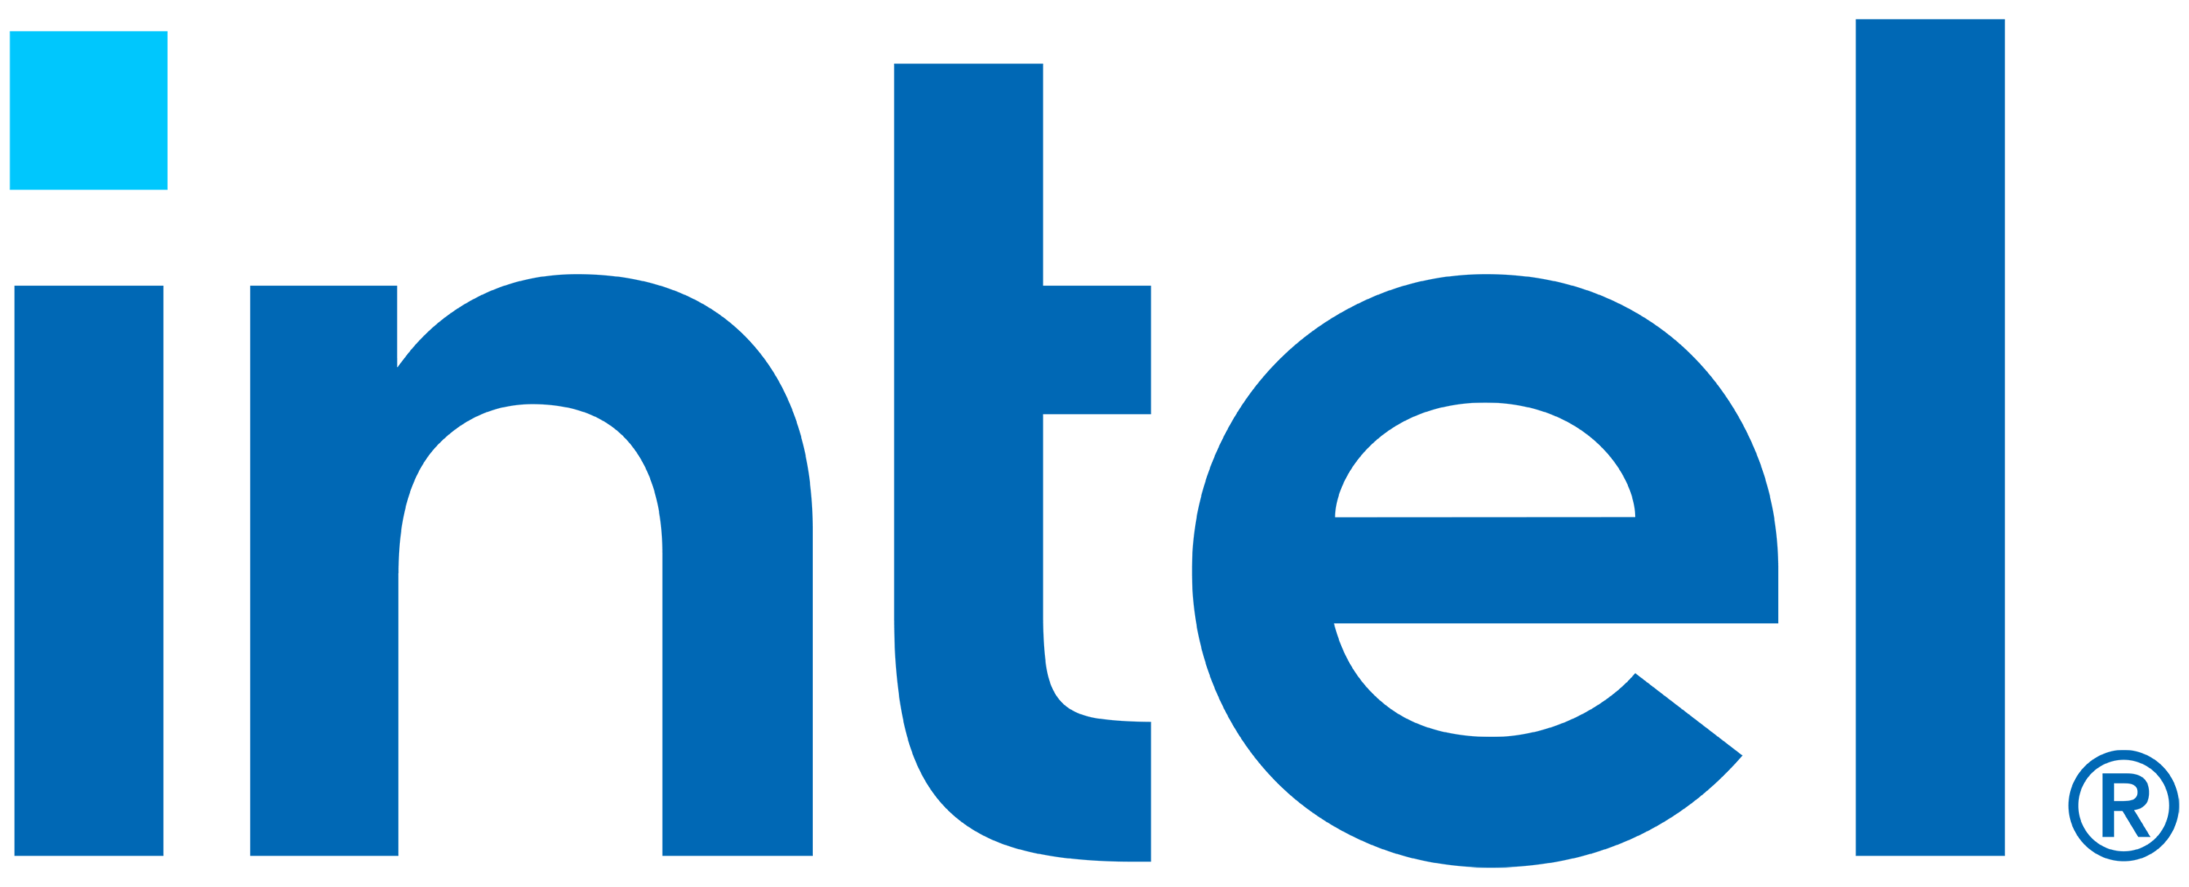
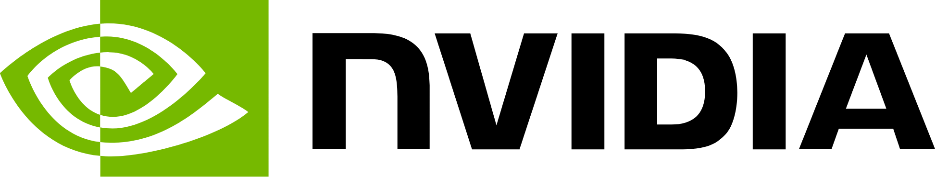
Confidential computing @ Azure
New @ Ignite Nov 2023
Services
SQL IaaS on confidential VMs
SQL always encrypted with secure enclaves
Azure Virtual Desktop on confidential VMs
Azure Data Explorer
Azure Confidential Databricks
Generally available
Generally available
Generally available
Public Preview
Generally Available
Managed HSM
Microsoft Azure Attestation
Azure Confidential Ledger
Azure
Managed CCF
Generally available
Generally available
Generally available
Public Preview
Containers
Confidential VM regions:
West US
East US
West Europe
North Europe
Switzerland North
Italy North
Germany West Central
UAE North
Southeast Asia
East Asia
Japan East
Central India
Intel SGX app enclave nodes on AKS
Confidential VM AKS worker nodes
Confidential containers on ACI
Confidential containers on AKS
Generally available
Generally available
Generally available
Public Preview
Virtual machines
DCa/ECa SEV-SNP VMs
DCsv2/DCsv3/DCdsv3 Intel SGX VMs
NCC NVIDIA VMs
DCesv5 Intel TDX VMs
Generally available
Generally available
Limited Preview
Public Preview
Notes:
The Azure confidential computing portfolio can be broken into three tiers: virtual machines, container service options, and other PaaS and SaaS.
At the VM tier are our confidential VMs using AMD SEV-SNP (GA), AMD SEV-SNP confidential VMs paired with NVIDIA H100 Tensor Core GPUs (in preview and an industry first), and Intel TDX confidential VMs (public preview); and our Intel SGX VMs with application enclaves which allow multiple code sections within a single VM to each have their own protected memory space. Our AMD SEV-SNP confidential VMs are now available in 12 regions in the US, EMEA, and Asia as shown in the lower right.
At the container services tier are our Kubernetes node pool options: Intel SGX app enclave node pools (GA), AMD SEV-SNP confidential VM node pools (GA), and AMD SEV-SNP confidential container node pools which allow each pod to have its own protected memory space; and our serverless confidential container offering: Confidential containers on Azure Container Instances, with each container group having its own protected memory space.
Our other services tier includes services powered by AMD SEV-SNP confidential VMs: SQL IaaS on confidential VMs (GA), Windows 11 Azure Virtual Desktop on confidential VMs (GA), Azure Data Explore on confidential VMs (Public preview), and Azure Databricks on confidential VMs (GA); and services powered by Intel SGX VMs with app enclaves: SQL always encrypted with secure enclaves (GA), Azure Key Vault Managed HSM (GA), Microsoft Azure
Attestation (GA), Azure Confidential Ledger (GA), and Azure Managed Confidential Consortium Framework (Public preview).
For an overview of the entire ACC portfolio and how these services work together to support a Zero Trust Architecture on Azure, download our O’Reilly report: Azure confidential computing and Zero Trust: https://aka.ms/ACC-ZT-blog.

Slide 32


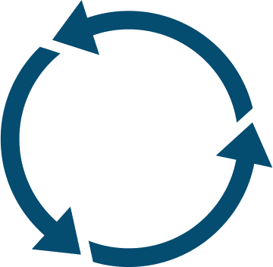




Microsoft sustainability goals
Carbon negative by 2030
Water positive by 2030
Zero waste by 2030
Protect more land by 2025
19.8 gigawatts of renewable energy assets contracted
Notes:
Microsoft addresses how our cloud infrastructure impacts the environment and communities by investing in advanced development projects for carbon, waste, water, and ecosystems. Our sustainability commitments include protecting land, being water positive, generating zero waste, and matching 100% of our energy consumption with zero-carbon sources.
As we build our datacenters, we’re working to grow our portfolio of renewable energy projects. In fact, today, we are one of the largest buyers of renewable energy around the globe. We’ve contracted a total of over 19 gigawatts of renewable energy assets, including projects in 21 countries around the world.
And we’re working with producers to bring on new energy from wind, solar, geothermal, and nuclear fusion, as well.

Slide 33

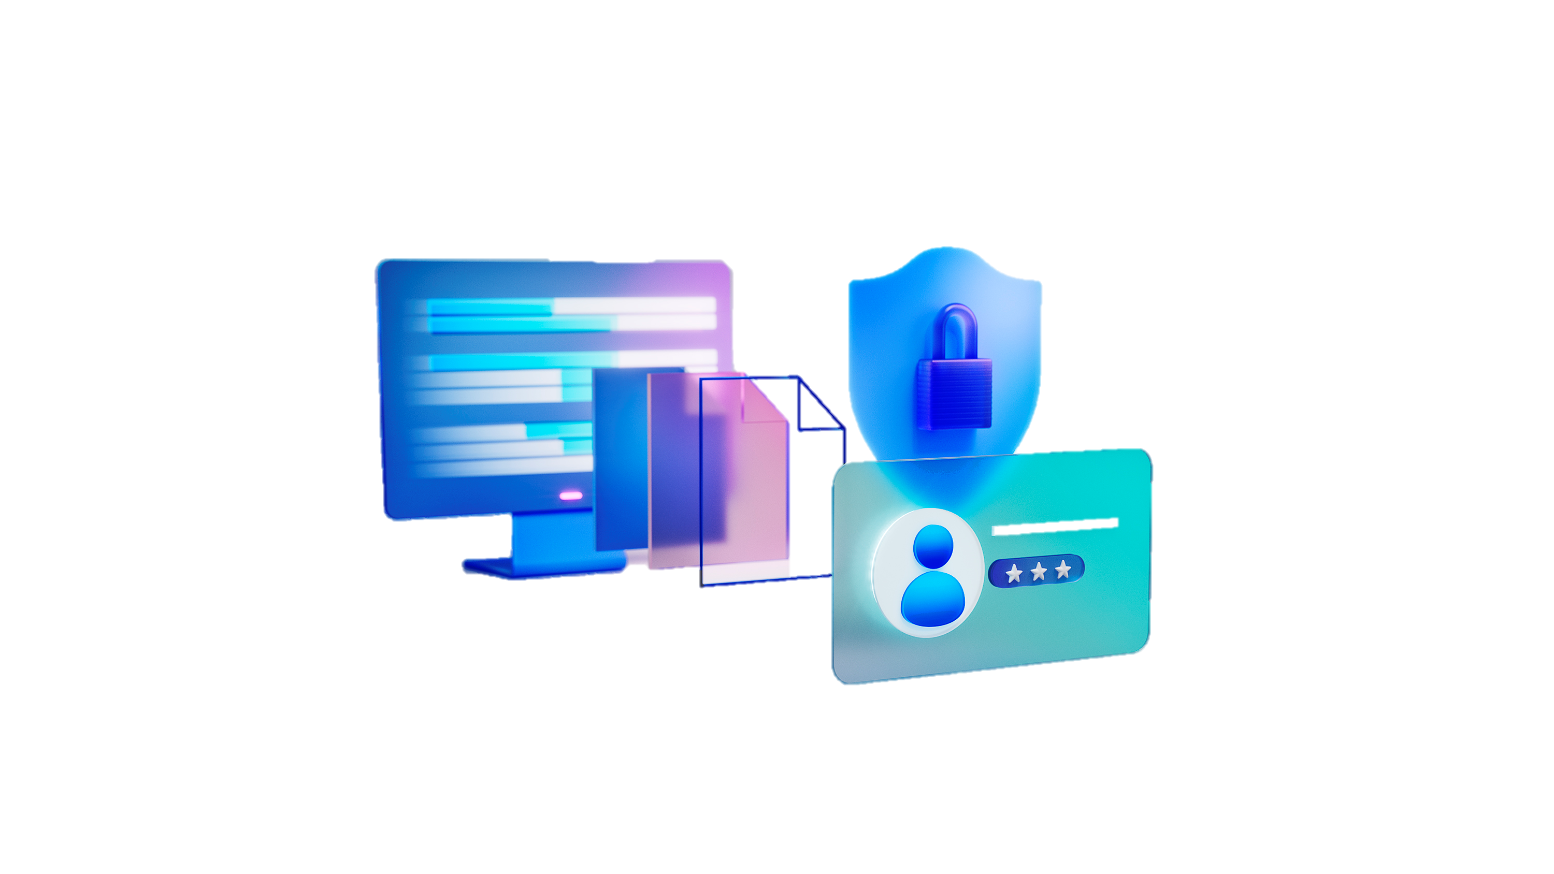
98% of cyber attacks can be prevented with basic security hygiene
2.5B+AI-powered cloud-based detections per day.
79% of endpoint detections powered by Microsoft machine learning models.
1M+ companies use Microsoft security solutions.
15K Microsoft security partners, more than anyone else.
Notes:
98% of cyber attacks can be prevented with basic security hygiene.
Overall, more than 2.5B cloud-based detections per day are driven by AI and today Microsoft machine learning models power nearly 79% of the endpoint detections, and
More than one million organizations across every industry – from BP and Fujifilm, to ING Bank, iHeart Media, and Lumen Technologies – now use Microsoft security solutions, up 26 percent year over year.
Microsoft has over 15,000 partners in our security ecosystem, more than anyone else in the industry.

Slide 34



















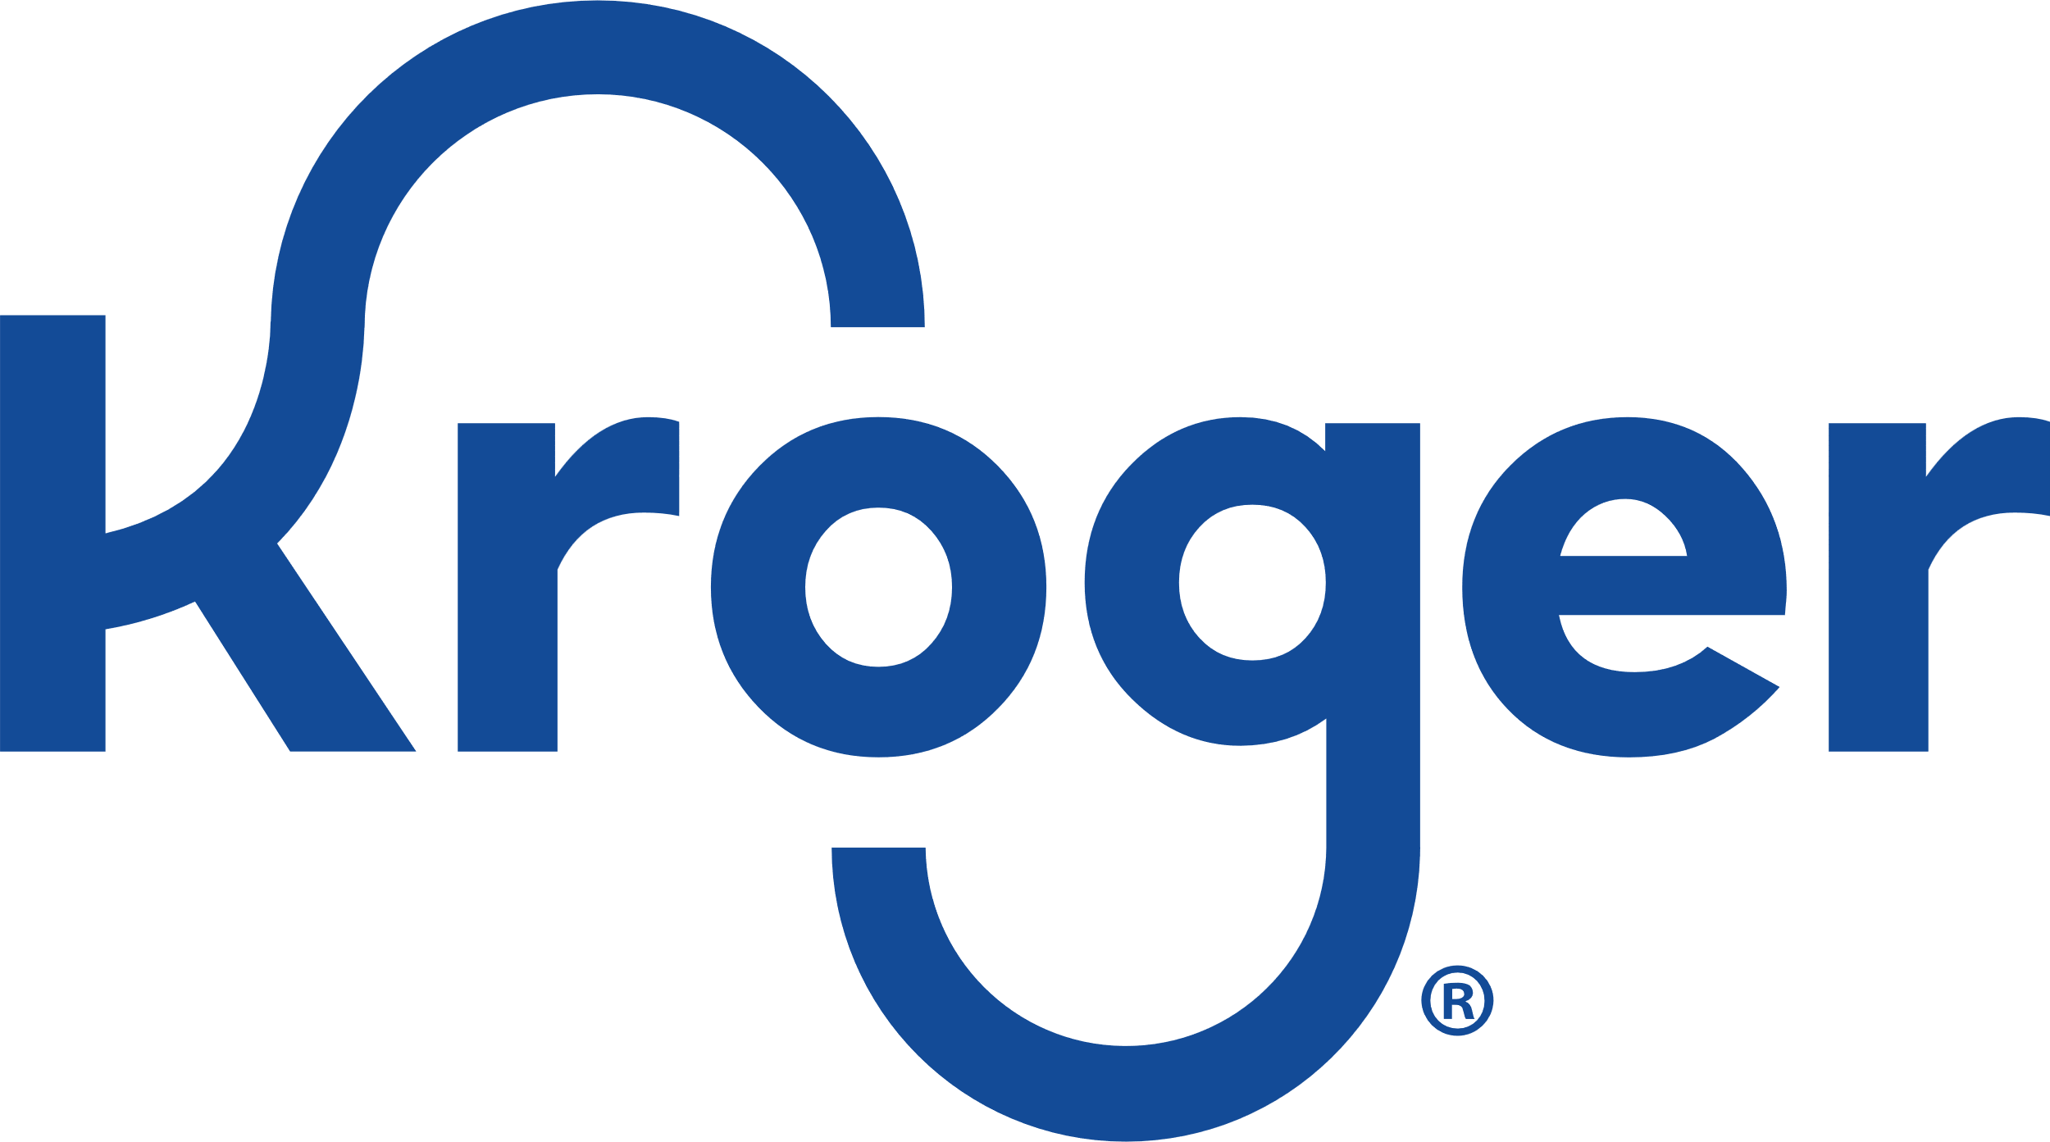















Fortune 500 logos
>95%
of Fortune 500 trust Azure with their business
Notes:
Why rely on Azure?
Many of the world’s most successful companies are already choosing Azure to power cutting-edge innovation across all industries - from retail to automotive to airlines. In fact, over >95% of Fortune 500 companies trust Azure with their business and are leaning on our capabilities to differentiate, grow and achieve really meaningful things for their businesses.
Source:
https://azure.microsoft.com/en-us/blog/microsoft-azure-the-only-consistent-comprehensive-hybrid-cloud/

Slide 35
End slide
Microsoft, Microsoft Azure, and other product names are or may be registered trademarks and/or trademarks in the US and/or other countries. The information herein is for informational purposes only and represents the current view of Microsoft Corporation as of the date of this presentation. Because Microsoft must respond to changing market conditions, it should not be interpreted to be a commitment on the part of Microsoft, and Microsoft cannot guarantee the accuracy of any information provided after the date of this presentation. MICROSOFT MAKES NO WARRANTIES, EXPRESS, IMPLIED, OR STATUTORY, AS TO THE INFORMATION IN THIS PRESENTATION.

Slide 36
Appendix

Slide 37

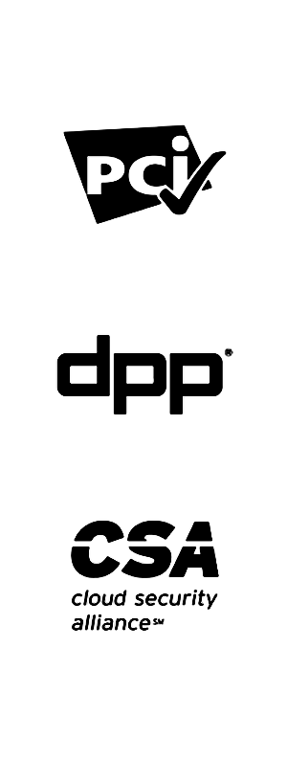


Compliance
100+ compliance offerings
The most comprehensive compliance coverage of any cloud service provider.
Notes:
Trust in cloud computing requires that services and data are available when you need them.
You want assurance that your data will not only be available, but also be both accessible and secured against unauthorized access, tampering, loss, and other dynamic threats to privacy and security—but new regulations and standards have increased compliance and data protection requirements. Azure provides a collection of integrated cloud services that help protect your business assets.
Providing a trusted cloud for our customers begins with our compliance standards. With more than 100 compliance offerings, we have the most comprehensive compliance portfolio of any cloud provider on the market. Our expertise in providing compliance offerings gives us the ability to customize compliance offerings to meet any specific needs—global, local/regional, and/or industry—a customer may have.

Slide 38
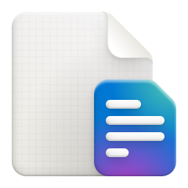
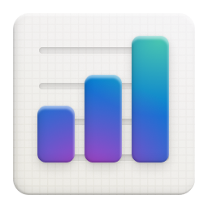
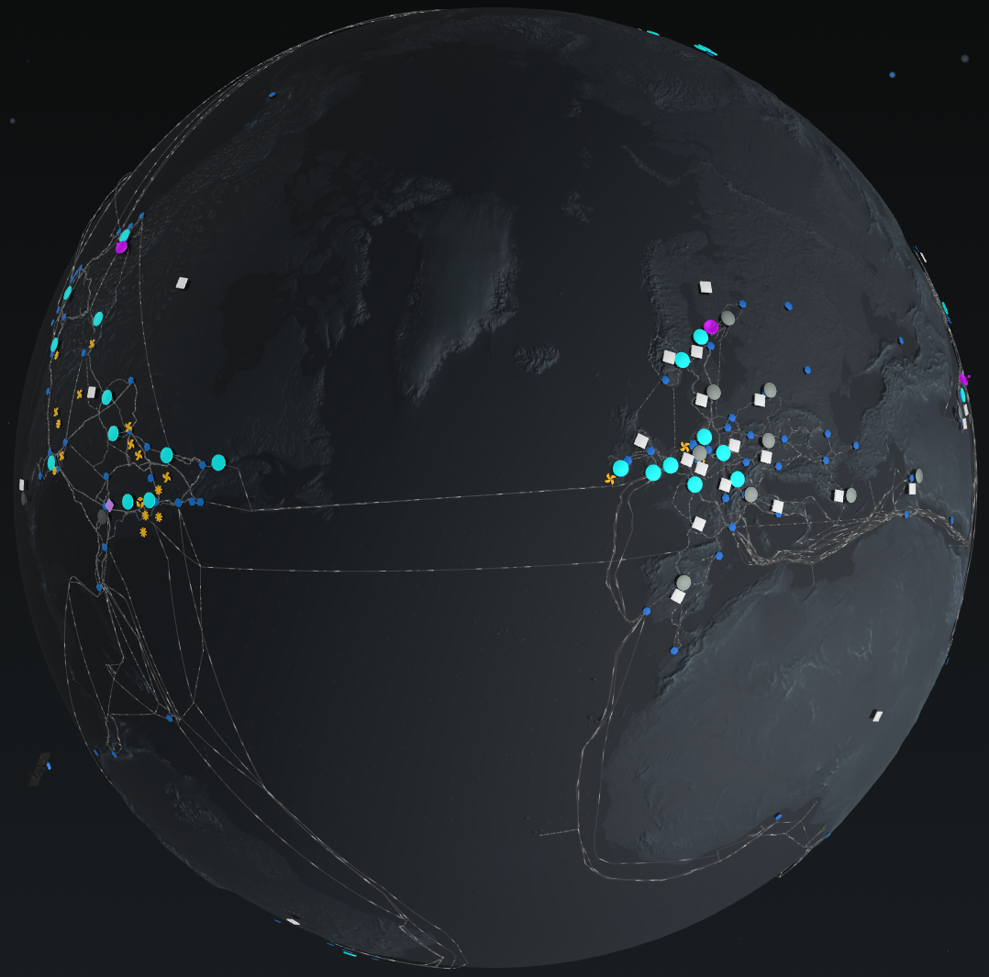


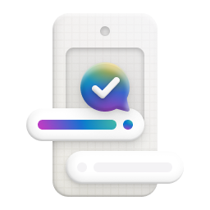
Compliance – EU data boundary
Coming soon
EU data boundary for Microsoft Cloud
Storing and processing customer data in the European Union.
Notes:
If you are a commercial or public sector customer in the EU, we will go beyond our existing data storage commitments and enable you to process and store all your data in the EU—in other words, we will not need to move your data outside of the EU. Microsoft cloud services already comply with or exceed EU guidelines, even before the plan we announced. We already provide commercial and public sector customers the choice to have data stored in the EU, and many Azure cloud services can already be configured to process data in the EU as well. In addition, we use world-class encryption and robust lockbox solutions that meet current regulatory guidance. Many of our services put control of customer data encryption in customers’ hands through the use of customer-managed keys, and we defend our customers’ data from improper access by any government in the world.
By the end of 2022, core cloud services will both store and process in the EU all personal data of our EU commercial and public sector customers, if they so choose. This plan includes any personal data in diagnostic data and service-generated data as well as personal data we use to provide technical support. We will also extend technical controls such as Lockbox and customer-managed encryption for customer data across Microsoft core cloud services. We will build these EU Data Boundary solutions into our core cloud services to enhance our current offerings for customers.
https://blogs.microsoft.com/eupolicy/2021/12/16/eu-data-boundary-for-the-microsoft-cloud-a-progress-report/

Slide 39
Key Vault roles
Understand how Key Vault meets the needs of developers and security administrators.
Role | Problem statement | Solved by Azure Key Vault
Developer for an Azure application | "I want to write an application for Azure that uses keys for signing and encryption. But I want these keys to be external from my application so that the solution is suitable for an application that's geographically distributed. I want these keys and secrets to be protected, without having to write the code myself. I also want these keys and secrets to be easy for me to use from my applications, with optimal performance." | Keys are stored in a vault and invoked by URI when needed. Keys are safeguarded by Azure, using industry-standard algorithms, key lengths, and hardware security modules. Keys are processed in HSMs that reside in the same Azure datacenters as the applications. This method provides better reliability and reduced latency than keys that reside in a separate location, such as on-premises.
Developer for software as a service (SaaS) | "I don't want the responsibility or potential liability for my customers' tenant keys and secrets. I want customers to own and manage their keys so that I can concentrate on doing what I do best, which is providing the core software features." | Customers can import their own keys into Azure and manage them. When a SaaS application needs to perform cryptographic operations by using customers' keys, Key Vault does these operations on behalf of the application. The application does not see the customers' keys.
Chief security officer (CSO) | "I want to know that our applications comply with FIPS 140 Level 3 HSMs for secure key management. I want to make sure that my organization is in control of the key lifecycle and can monitor key usage. And although we use multiple Azure services and resources, I want to manage the keys from a single location in Azure." | Choose vaults or managed HSMs for FIPS 140 validated HSMs. Choose managed HSM pools for FIPS 140-2 Level 3 validated HSMs. Key Vault is designed so that Microsoft does not see or extract your keys. Key usage is logged in near real time. The vault provides a single interface, regardless of how many vaults you have in Azure, which regions they support, and which applications use them.
Notes:
https://azure.microsoft.com/en-us/products/key-vault
Azure Key Vault is a cloud service for securely storing and accessing secrets. A secret is anything that you want to tightly control access to, such as API keys, passwords, certificates, or cryptographic keys. Key Vault service supports two types of containers: vaults and managed hardware security module(HSM) pools. Vaults support storing software and HSM-backed keys, secrets, and certificates. Managed HSM pools only support HSM-backed keys.

Slide 40

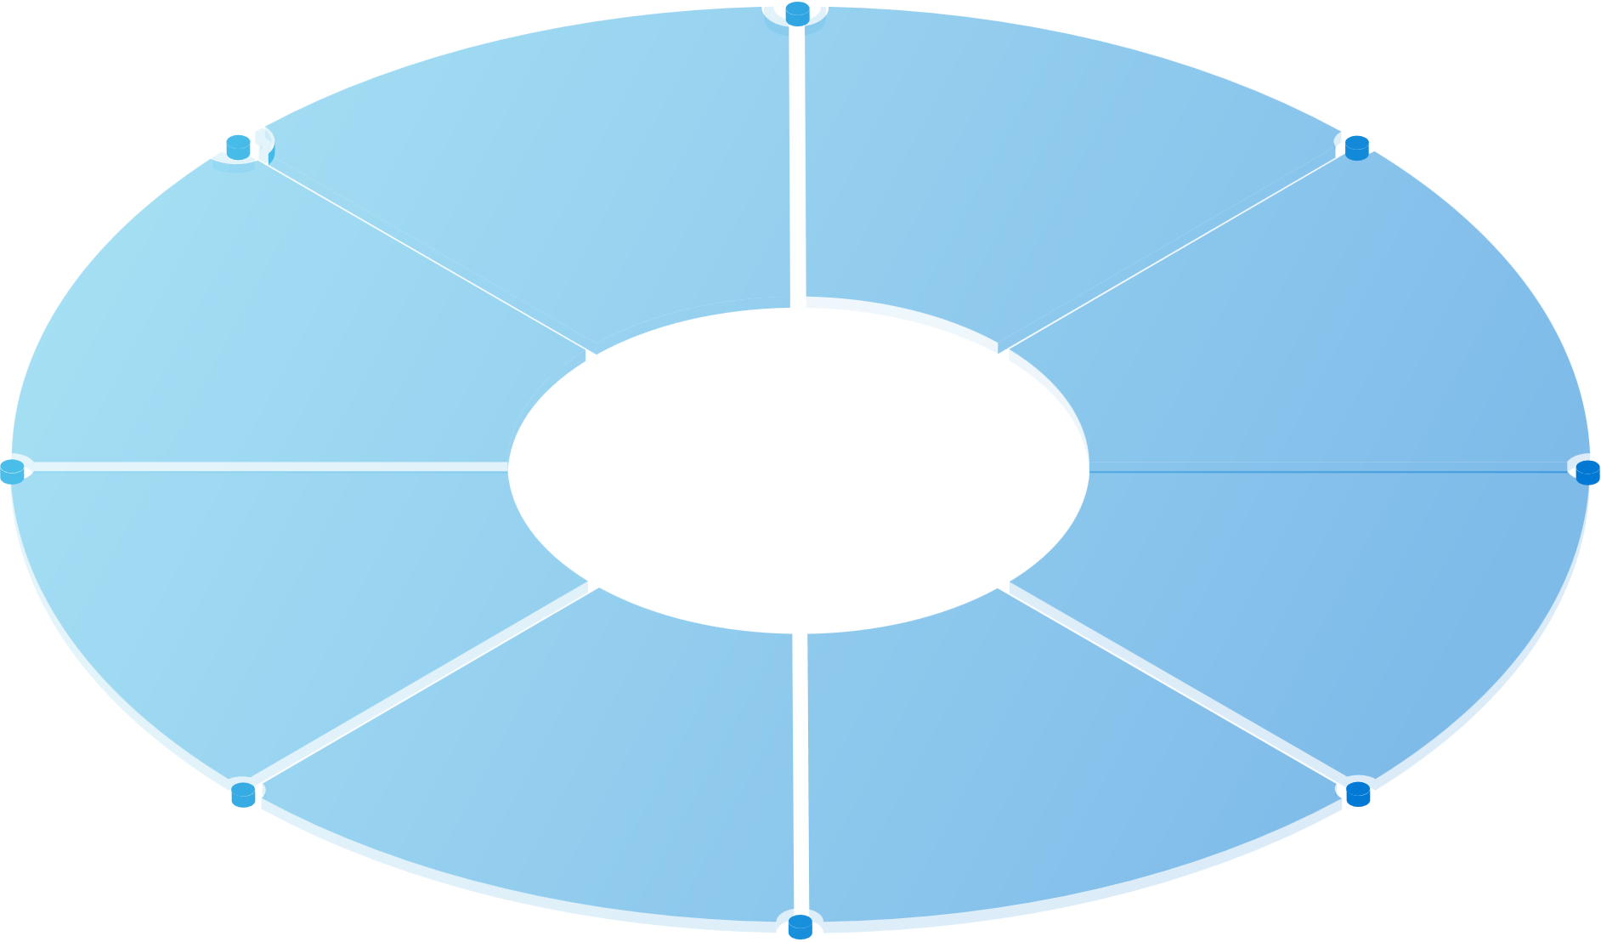
Azure network security
Protect your applications and cloud workloads from network-based cyberattacks with layered defense cloud native services
A zero-trust approach
Stop attacks at network edge
Network segmentation via virtual network
Notes:
Azure Network Security - Layered defense approach with cloud-native services
A Zero Trust approach
Stop attacks at network edge
Network segmentation via virtual network

Slide 41
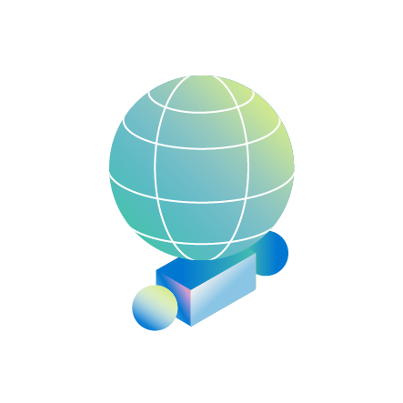
Unmatched protection and compliance
$20B+
5 year investment in cyber security
8T+
signals analyzed in every 24 hours
100+
compliance certifications
400K+
customers trust Microsoft security solutions.
3,500
Daily attacks mitigated by Azure DDos Protection in 2023.
2T
network flows blocked by Azure Firewall in 2021.
Notes:
Stay compliant and protect against security threats with unmatched investment, protection, and compliance certifications.
We invest over $1B a year in security and have more than 3,500 security experts who make sure our platform and service and your applications are always secure.
Microsoft is one of the largest security technology providers in the industry, with more than 400K customers trusting their businesses on Microsoft security solutions.
We offer the most comprehensive and integrated threat protection against the most sophisticated attacks. Our system analyzes more than 8 trillions signals every day from all sources, and over 6 billion malware threats were blocked by Microsoft Defender in 2020.
When it comes to compliance, we have the largest number of compliance certifications, including over 50 compliance offerings specific to regions and countries, and more than 35 compliance offerings specific to industries.

Slide 42
Microsoft Foundational Security: Azure
Identity & Network Access | Risk Reduction & Posture Management | Secure Software Supply Chain | Microsoft Global Security Operations
Role Based Access Controls (RBAC / ABAC) | Cloud Security Posture Management (CSPM) | Industry thought leadership & contribution to standards | 24*7 global monitoring and response teams
Cloud-platform with Identity Federation | Automated policy and governance | Secure Software Development Lifecycle (SDL) | Most comprehensive threat intelligence data analysis
Single Sign-On across multi-cloud / hybrid-cloud | Secure Score and Regulatory Compliance | Azure DevOps + GitHub | Global investigations for fraud, phishing, and ransomware
Multi-factor authentication and threat detection | Customer Experience Teams to assist with best-practices | Contribution and support of Open-Source Software | Combating nation-state threats
Anti-malware, segmentation, and secure remote access built in | Multi-layer encryption & Confidential Computing | Comprehensive guidance, training, and certification | Advanced vulnerability management with strong bug-bounty program
Users, Groups, and Devices |  |  | Expertise in cyber laws and government policy
Defense in depth
Notes:
Let’s dig deeper into each of the 4 Azure Foundational Security differentiators in more detail. Each pillar and its subsequent technology capabilities are all embedded in Azure, at no additional cost to the customer
Identity & Network Access:
One of the most important aspects of securing a cloud platform is to ensure only trusted and authorized users, devices, and applications can gain access
Azure provides one of the best identity platforms as part of the customer investment. Azure AD is recognized as a leader in identity and network access capabilities
Customers may also own advanced licenses to use the Azure AD premium features, if they are also an M365 customer
Risk Reduction & Posture Management:
Cloud customers need to ensure the workloads they have deployed are done so securely and remain configured according to latest guidance and regulations
Defender for Cloud provides free assessments for Azure, AWS, and GCP
Microsoft also provides customer resources to help engage with experts in many industries and fields of expertise to guide their design and deployment options
Encryption is on by default for storage and transit, advanced options are available if a customer needs them
Confidential computing is currently an optional choice, in future it could become the default standard for all VM based compute
Secure Software Supply Chain:
This covers both the way the Microsoft runs its own DevSecOps processes, and the customers choices for ensuring they develop and deploy their own code securely within Azure
Open-Source Software can account for 90% of many business applications, ensuring that code remains secure requires comprehensive approach to SDL and 3rd Party software supply chain
GitHub is used by most of the worlds top companies to store and run their code, Microsoft acquired GitHub to ensure it is well protected and available at all times.
Azure DevOps provides some free capabilities if the company only has a few developers and small projects, for more advanced workloads there are paid-for options to increase capabilities.
Microsoft also recently launched the OSS Supply Chain Framework, a security assurance and risk reduction process that is focused on securing how developers consume open source software. [OSS Secure Supply Chain Framework (microsoft.com)]
Microsoft Global Security Operations:
Sometimes it’s the unsung hero’s that really make the difference in cyber-security. The work these teams do usually go unnoticed, which is by design
Microsoft is THE leading security company both for the products that we have developed, but more importantly the people that have done the research, fight crime, investigate nation-state actor behaviors, and go to the law courts to ensure bot-nets and other attacker infrastructure are permanently removed from the internet
Within the global security community, Microsoft has a strong reputation for the work our teams do both within Microsoft (red team / blue team), and with our industry partners (including Amazon, Google, Mandiant, Proofpoint and more), ensuring all our customers are well protected from next-level threats every day.
Microsoft has a very strong bug-bounty and security researcher community outreach program. Whilst this will sometimes result in an increased public disclosure of vulnerabilities, it shows that we are proactively finding, mitigating, and resolving any bugs and design faults – before the threat actors do.

Slide 43
Microsoft’s Reliability Principles in Azure AD
Highly Redundant
Safe Deployment
No single points of failure
Modern Verification
Blast radius reduction with cell-based architecture
Multiple levels of isolation
Independent backup authentication service
Elastic scalability
Notes:
These are the core principles that are built on Microsoft’s resiliency approach and are used by Azure AD for reliability.
The service is run in a highly redundant manner -- within a data center all data is replicated at least 9 times. We regularly validate the redundancy of the service by exercising failure and fault injection – up to Data Center drills.
We ensure that no single system internal or external can impact the availability of the service and that includes systems like DNS or CDN's where we employ at least 2 active/active systems. To illustrate in July there were some public DNS outages but because Azure AD depends on multiple providers in an Active/Active manner there was 0 disruption.
Multiple levels of isolation ensure physical separation of service components. For example, if one of MFA methods – phone or sms – fails, this design principle ensures that other methods and authentication don’t get interrupted.
Elasticity scales - Azure AD is a massive system running on over 300,000 CPU Cores and able to rely on Azure Cloud to rapidly scale up to meet any demand. Last year we had to bring entire national educational systems online in matter of weeks, and service ran without interruption.
One of the core resiliency principles is Safe Deployment – we will talk about it in more detail in the next slide.
Modern verification supports the health checks that gate safe deployment and give our engineering team insight into the health of the systems, Azure AD emits over 11 PetaBytes a week of signals that feed our automated health monitoring systems, and alerts our team of 24/7/365 engineers to respond to any potential service interruption. In most recent outage service telemetry identified the problem, and the engineering team was automatically engaged.
Our work to improve resilience is on-going. One area is our Cell-based architecture: our strongest isolation are our physical cells that are analogous to compartments in a submarine and are designed to contain faults and maintain the integrity of the vessel or in this case Azure AD even if there is a fault in a given compartment. In the next few months we're actively evolving the service from 5 cells to over 50 with plans to get into the hundreds beyond that. At this point, 60% of overall Azure AD traffic has been migrated, and we’re on track to complete 100% of traffic migration by end of June.
To add even more layers of redundancy, we’ve built and are in the process of rolling out an entirely independent (decorrelated) backup authentication service that seamlessly and transparently takes over, if there are failures in all the other layers of resilience in Azure AD.
In September 2020 backup service that was in place for Outlook Web App and SharePoint online drastically reduced customer impact (93.8% of OWA users were not impacted). Unfortunately, it did not help in the recent outage as it provided coverage for token issuance but did not provide coverage for token validation as that was dependent on the impacted metadata endpoint.

Slide 44
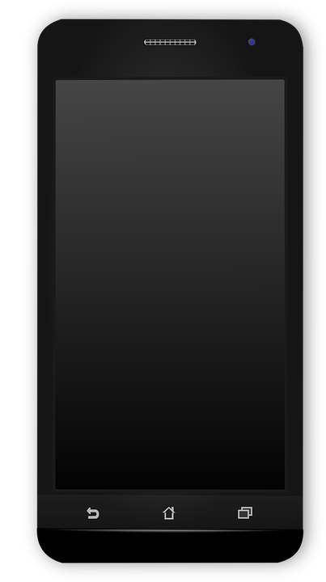
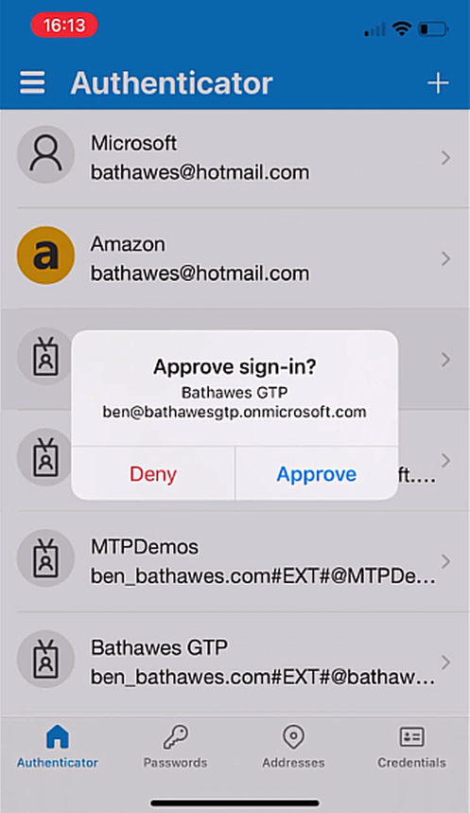
MFA registration and sign-in (Authenticator app)
Supports NIST AAL level 2
Users can self-service install the app
Allows passwordless sign-in (if enabled)
Notes:
NIST: National Institute of Standards and Technology

Slide 45
Security posture management with enhanced Secure Score
Access
Evaluated categories
Compute
SQL Server
Network
App
Gain instant insight into the security state of your cloud workloads
Address security vulnerabilities with prioritized recommendations
Improve your secure score and overall security posture in minutes
Speed up regulatory compliance
+7%
+2%
+1%
+3%
+2%
Secure Score impact
50%
Secure Score
Notes:
Microsoft Defender for Cloud enables you to strengthen your security posture by helping you identify and perform the hardening tasks recommended as security best practices, then implement them across your machines, data services, and apps. Strengthening your posture includes managing and enforcing your security policies. It also means you should verify compliance among your Azure virtual machines, non-Azure servers, and Azure PaaS services. Microsoft Defender for Cloud provides the tools you need to have a bird’s-eye view of your workloads, with focused visibility on your network security estate.
With so many services offering security benefits, it's often difficult to know which steps you should take first to secure and harden your workload. Your Secure Score reviews your security recommendations and prioritizes them for you. This helps you find the most serious security vulnerabilities and enables you to prioritize investigation. Our Secure Score tool helps you assess your workload security posture.
Let’s talk about cloud security posture management enhancements. The most common cause of security breaches for cloud workloads is misconfiguration. Microsoft Defender for Cloud provides you with a bird’s-eye view across your Azure environment, which enables you to continuously monitor and improve your security posture using Azure Secure Score. Microsoft Defender for Cloud helps manage and enforce your security policies to identify and fix misconfigurations across your different resources and maintain compliance. We continue to expand our resource coverage and the depth insights available in security posture management.
Now let’s talk about Secure Score. Secure Score is the foundation of Microsoft Defender for Cloud's security posture management. We recently introduced enhanced Secure Score controls. These new controls group multiple recommendations that focus on a specific attack surface, such as restricting access to management ports. With these controls, you’ll get better visibility into your secure score and provide a more reliable method for calculating your score. We recommend you familiarize yourself with the latest Secure Score changes and determine any remediations you can undertake to further secure your environment.

Slide 46




Multi-cloud & hybrid protection in Microsoft Defender for Cloud
Google Cloud
Amazon Web Services
On-premises
Microsoft Azure
New!
New!
New!
Azure Arc
Security posture and compliance
Secure Score
Asset management
Policy
Server protection
(Azure Defender for VMs)
Threat detection
VA (power by Qualys)
Application control
Automation and management at scale
Automation
SIEM integration
Export
Notes:
Microsoft Defender for Cloud helps protect your multi-cloud and hybrid environments in several ways:
Easily onboard your multi-cloud estate, including Azure, AWS, and Google Cloud.
Integration with other CSP-native security solutions
Leverages Azure Arc to bring non-Azure resources into ARM
Extensible platform in a standardized format (policy, LogicApp)
One agent, one management, one policy for all platforms (Azure, AWS, GCS)

Slide 47
Three-fold approach to cloud security
Monitor and control activities and data across all apps
Integrated visibility and protection across clouds
Develop and operate secure apps in the cloud
Cloud Access Security Broker
Cloud Security Posture Management
Cloud Workload Protection Platform
Application Security
Notes:
We have taken a three-fold approach to cloud security:
Our Cloud Access Security Broker provides a centralized approach to monitor and protect the flow of and access to critical data using a consistent set of controls across any cloud app in your organization. We do this on Microsoft, third-party, or custom apps, all of which are critical to your business.
Our Cloud Security Posture Management and Cloud Workload Protection Platform solutions provide an approach to realize integrated visibility, posture management, and protection across clouds. Whether it’s Azure or AWS, these solution will help you ensure a secure cloud environment.
Application security for developers. We provide tools in the cloud, from development to operations, that empower you to build secure applications faster and ensure your data is protected throughout its lifecycle.

Slide 48
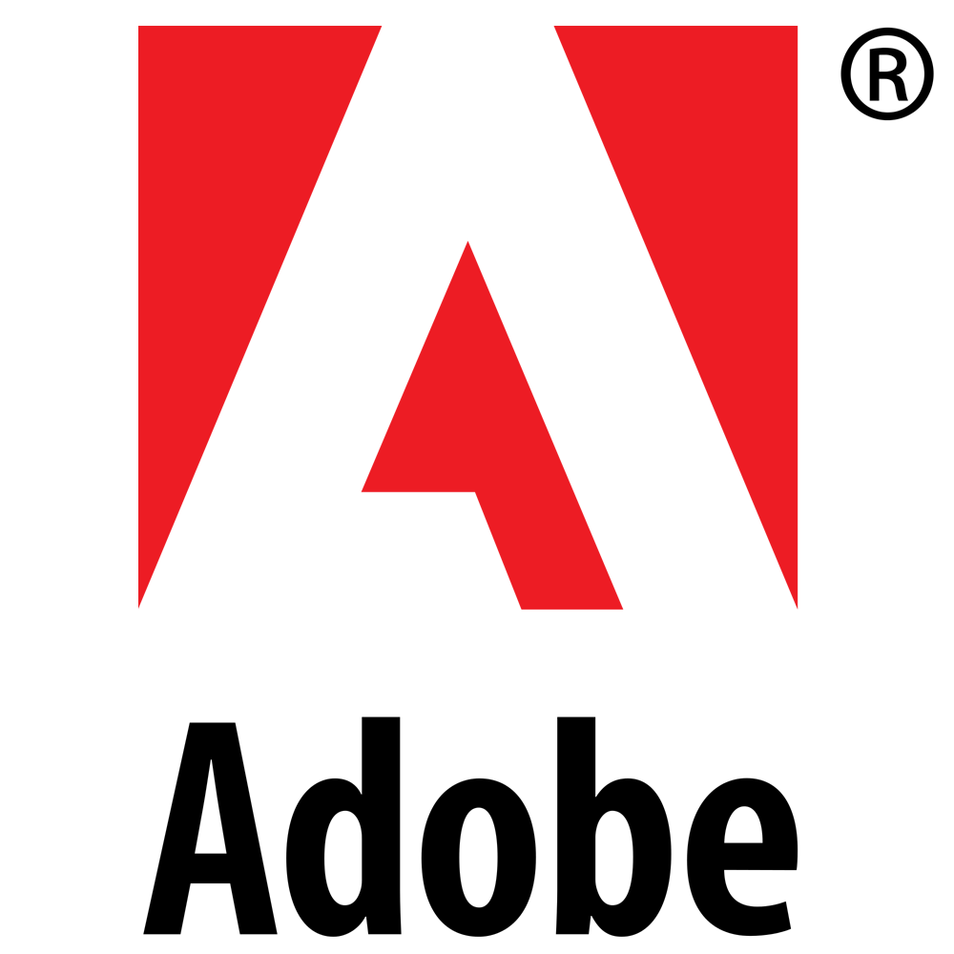
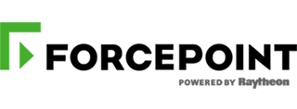
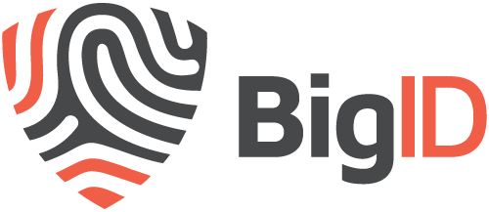
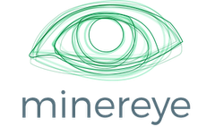














Broad ecosystem extends information protection
Cross-platform SDK extends classification, labeling, and protection to third-party apps and services
Enables consistent and comprehensive information protection experiences
Compatible with Microsoft information protection solutions
Notes:
In addition to providing a comprehensive set of information-protection capabilities, we also empower a growing ecosystem of third-party ISVs to extend information protection to their own apps and services, using our Information Protection SDK. For example, Adobe is building protection capabilities natively in Adobe Acrobat Reader using our SDK that understand labeled and protected files and can be opened natively within the app, without any additional plugins.

